Slide 1
Java

Slide 2
Day - 1
Java Basics

Slide 3
Java Basics
Java Installation
OOPS Concepts
Class and Object
Method and Constructor
Java Access Modifiers

Slide 4
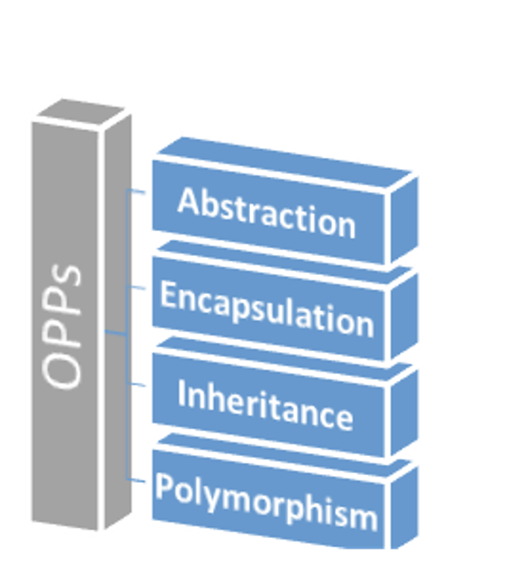
OOPS Concepts
Polymorphism: One task can be performed in many ways
In Java it is mainly divided into two types:
Static Polymorphism : Method and Operator overloading
Runtime Polymorphism : Method Overriding
Inheritance: Object acquires all the properties of
parent class
Encapsulation: Hiding data and property in one unit e.g. class
Abstraction: Hiding data and showing functionality
Can be achieved using Interfaces and Abstract classes in java
Class: Blueprint for creating projects
Object: have states and behaviours

Slide 5
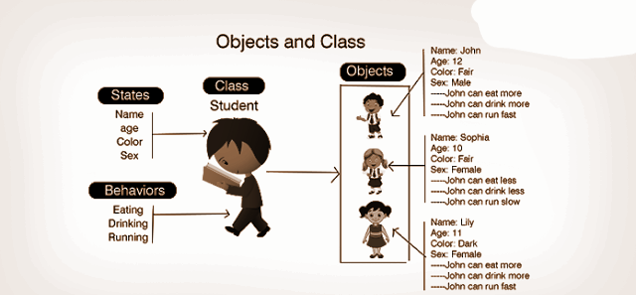
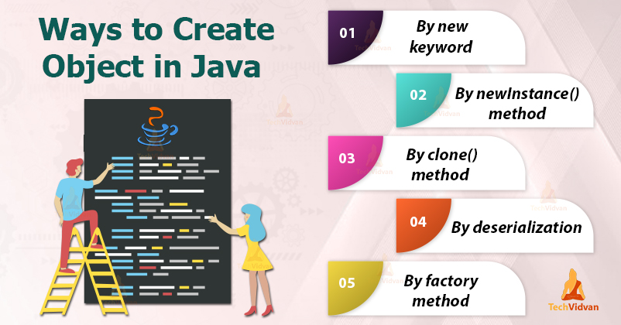
Class and Object
Class: Blueprint for creating projects
Objects: have states and behaviours

Slide 6
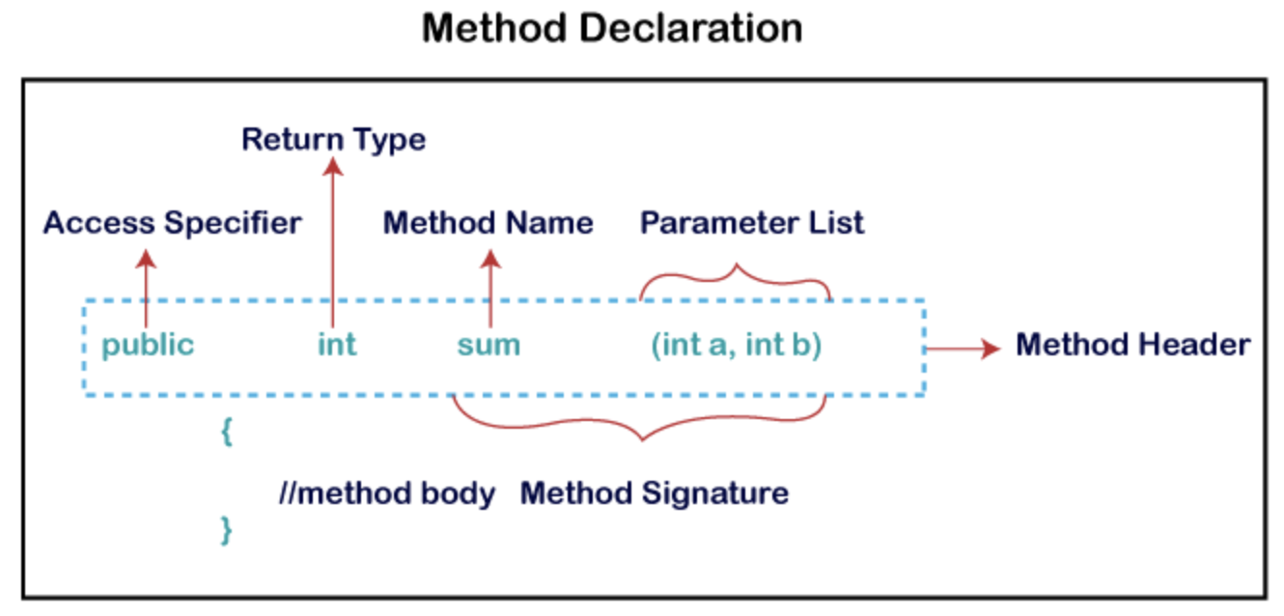
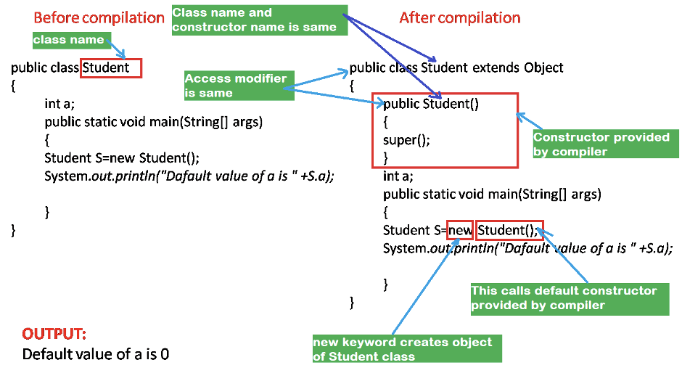
Method and Constructor

Slide 7
Java Access Modifiers
 | Default | Private | Protected | Public
Within class | Yes | Yes | Yes | Yes
Sub Class within package | Yes | No | Yes | Yes
Sub Class different package | No | No | Yes | Yes
Others | No | No | No | Yes

Slide 8
Handson topics/details
https://www.codesdope.com/practice/java-subclass/

Slide 9
Reference Links
Reference:
Java-basics
Beginners book
Core java cheat-sheet
Java installation guidelines
OOPs Concepts, class and object
Basics here
OOP with example
Java Constructor & Methods:
Constructor in java
Method in java
Constructor chaining
Method overding & overloading

Slide 10
Data Type and Operators
Data Types and Operators
Auto-boxing and Unboxing
Wrapper Classes
Control Flow - conditions, Loops
Keywords - final, static etc

Slide 11
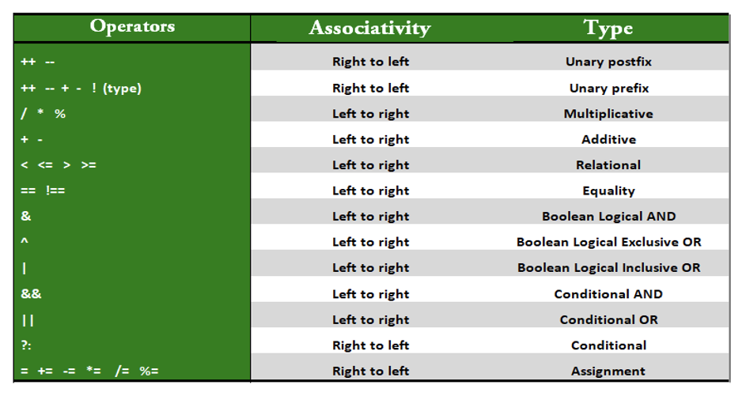
Operators
Java provides many types of operators which can be used according to the need. They are classified based on the functionality they provide.

Slide 12
Operators
Java provides many types of operators which can be used according to the need. They are classified based on the functionality they provide.

Slide 13
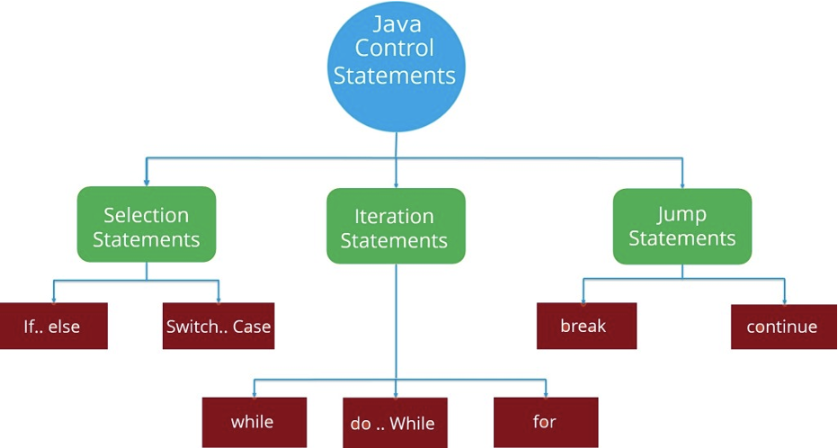
Control Flow - conditions, Loops
Generally the statements inside your java code are executed from top to bottom, in the order that they appear. Control flow statements, change or break the flow of execution by implementing decision making, looping, and branching your program to execute particular blocks of code based on the conditions.

Slide 14
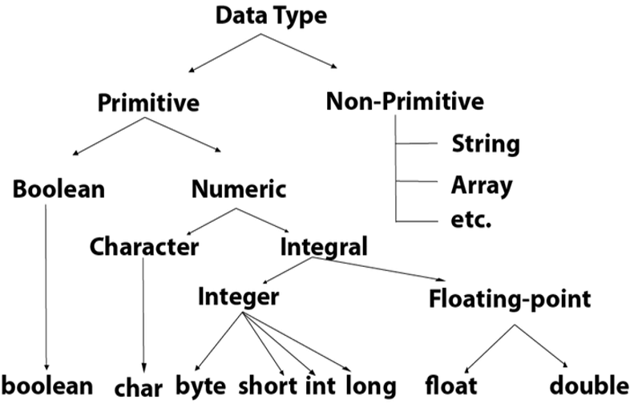
Data Types
Data types specify the different sizes and values that can be stored in the variable. There are two types of data types in Java
Primitive data types: The primitive data types include boolean, char, byte, short, int, long, float and double.
Non-primitive data types: The non-primitive data types include Classes, Interfaces, and Arrays.
Notes:
All small data types starting with small characters are basically primitive data types. All capital letters ones are non-primitives
Non-Primitive data types have same sizes & those are user declared. Primitive data types are system defined.
Use of Primitive data types -> For creating generic functions, classes, etc.

Slide 15
Auto-boxing and Unboxing and Wrapper Class
A Wrapper class is a class whose object wraps or contains primitive data types. When we create an object to a wrapper class, it contains a field and in this field, we can store primitive data types. In other words, we can wrap a primitive value into a wrapper class object.
Need of Wrapper Classes: Change the value in Method, Serialization,Synchronization,java.util package,Collection Framework
Autoboxing: Automatic conversion of primitive types to the object of their corresponding wrapper classes is known as autoboxing. For example – conversion of int to Integer, long to Long, double to Double etc.
Unboxing: It is just the reverse process of autoboxing. Automatically converting an object of a wrapper class to its corresponding primitive type is known as unboxing. For example – conversion of Integer to int, Long to long, Double to double, etc.

Slide 16
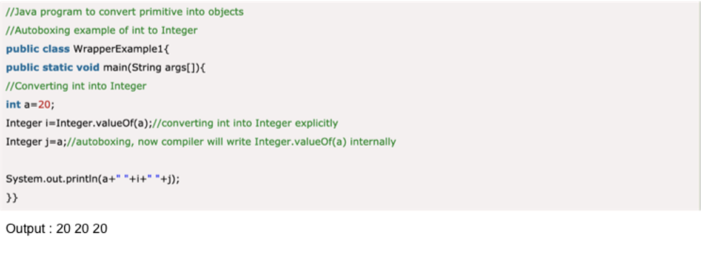
Auto-boxing and Unboxing and Wrapper Class

Slide 17
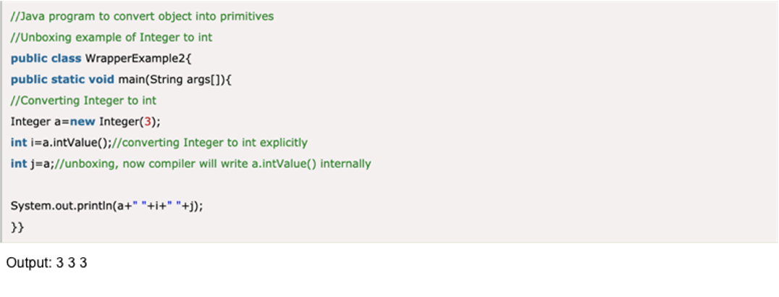
Auto-boxing and Unboxing and Wrapper Class

Slide 18
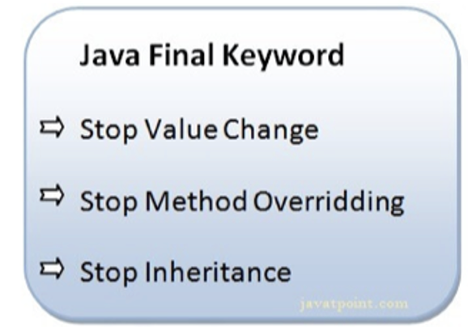
Keywords - Final and Static
Java has a set of keywords that are reserved words that cannot be used as variables, methods, classes, or any other identifiers:
Ex: final, static, while, try, void.
The Final keyword in java is used to restrict the user. The java final keyword can be used in many context. Final can be:
Variable
Method
Class

Slide 19
Keywords - Final and Static
The static keyword in Java is used for memory management mainly. We can apply static keyword with variables, methods, blocks and nested classes.
Static method: A static method belongs to the class rather than the object of a class and can be invoked without the need for creating an instance of a class.A static method can access static data member and can change the value of it.
Static block: Static block is used for initializing the static variables.This block gets executed when the class is loaded in the memory. A class can have multiple Static blocks, which will execute in the same sequence in which they have been written into the program.
Static variable: When you declare a variable as static, then a single copy of the variable is created and divided among all objects at the class level. Static variables are, essentially, global variables. Basically, all the instances of the class share the same static variable. Static variables can be created at class-level only.
Static class: A class can be made static only if it is a nested class. Nested static class doesn’t need a reference of Outer class. In this case, a static class cannot access non-static members of the Outer class

Slide 20
Handson topics/details
https://www.codesdope.com/practice/java-know-data-types/
https://www.codesdope.com/practice/java-operators/
https://www.codesdope.com/practice/java-decide-if-or-else/
https://www.codesdope.com/practice/java-loop-loop-loop/

Slide 21
Reference Links
https://www.w3schools.com/java/java_data_types.asp
https://www.geeksforgeeks.org/operators-in-java/
https://www.geeksforgeeks.org/autoboxing-unboxing-java/
https://www.javatpoint.com/static-keyword-in-java
https://www.geeksforgeeks.org/final-keyword-java/
https://www.w3adda.com/java-tutorial/java-control-flow-statements

Slide 22
Day - 3
Abstract Class and Interface

Slide 23
Abstract Class and Interface
Abstract Class
Interface
Interface vs Abstract Class
New features introduced in Interface

Slide 24
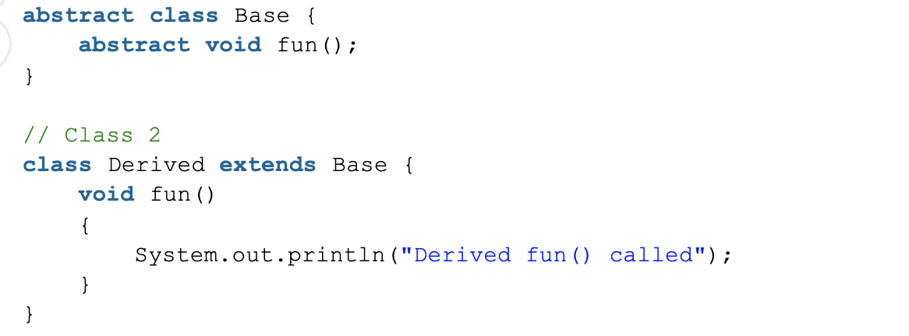
Abstract Class
A class which is declared as abstract is known as an abstract class. It can have abstract and non-abstract methods. It needs to be extended and its method implemented. It cannot be instantiated.
An abstract class must be declared with an abstract keyword.
It can have abstract and non-abstract methods.
It cannot be instantiated.
It can have constructors and static methods also.
It can have final methods which will force the subclass not to change the body of the method.

Slide 25
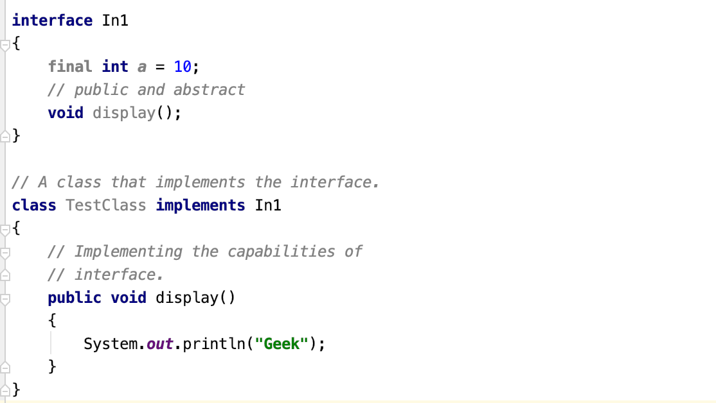
Interface
An interface in Java is a blueprint of a class. All fields are public, static, and final and the abstract methods are public by default.
The interface in Java is a mechanism to achieve abstraction and multiple inheritance in Java.
If a class implements an interface and does not provide method bodies for all abstract functions specified in the interface, then the class must be declared abstract
From Java 8 we can have default and static methods in Interfaces. Before this we can only have abstract methods i.e. methods with their definition and no implementation.

Slide 26
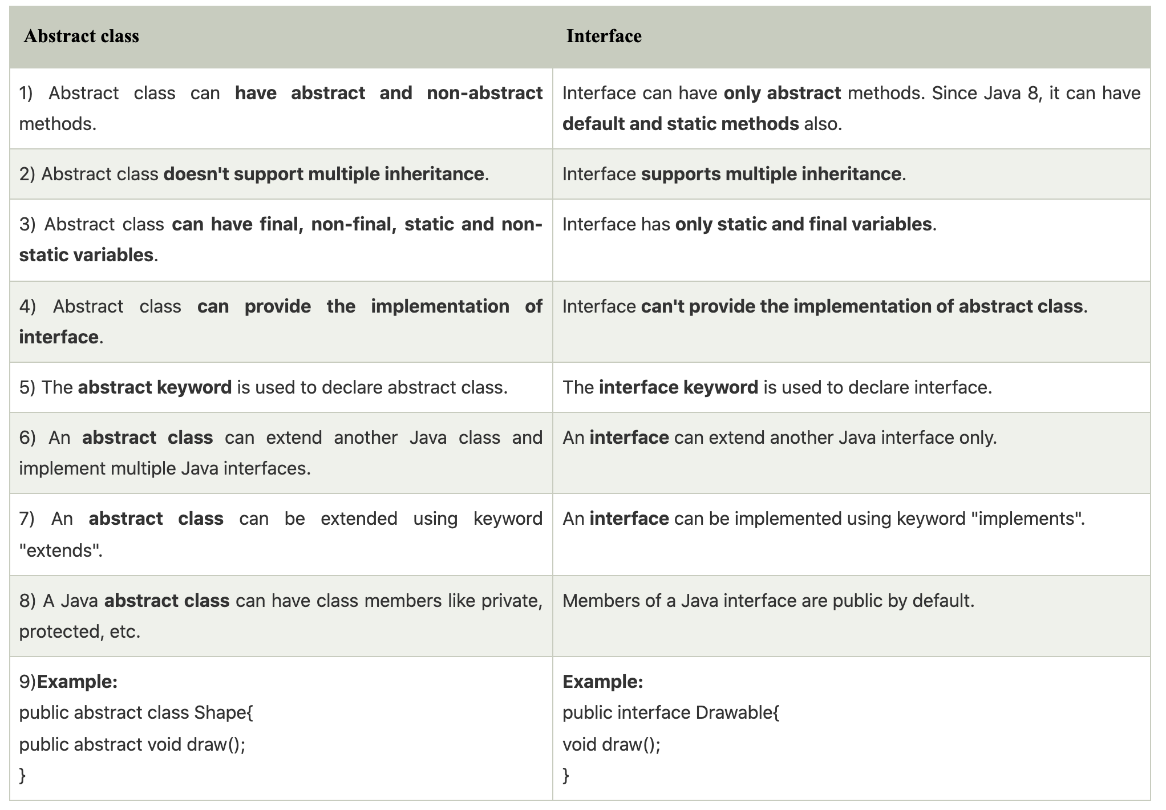
Interface vs Abstract Class

Slide 27
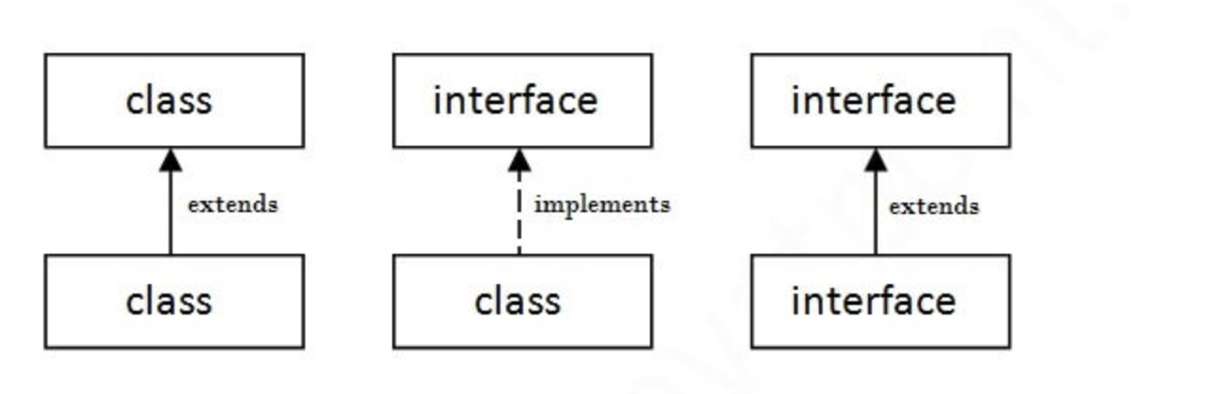
Extend vs Implement

Slide 28
New features introduced in Interface
Since Java 8, we can have default and static methods in an interface.
Since Java 9, we can have private methods in an interface

Slide 29
Handson topics/details
https://www.codesdope.com/practice/java-abstract-class/
https://www.tutorialspoint.com/when-to-use-an-abstract-class-and-when-to-use-an-interface-in-java

Slide 30
Reference Links
https://www.geeksforgeeks.org/interfaces-in-java/
https://www.geeksforgeeks.org/abstract-classes-in-java/
https://www.geeksforgeeks.org/difference-between-abstract-class-and-interface-in-java/
https://www.tutorialspoint.com/when-to-use-an-abstract-class-and-when-to-use-an-interface-in-java
https://www.javatpoint.com/abstract-class-in-java
https://www.javatpoint.com/interface-in-java

Slide 31
Day - 4
String Manipulations

Slide 32
String Manipulations
Understanding Java String Pool
String Operations
StringBuffer and StringBuilder

Slide 33
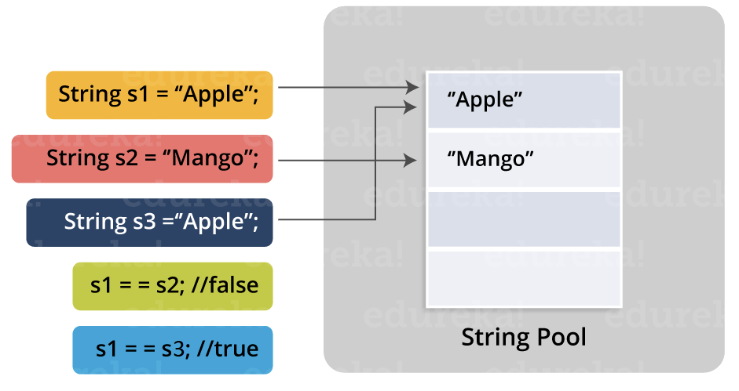
Understanding Java String Pool
Immutable
Why java allows us to change the value, if string is immutable ?
String Pool

Slide 34
String Operations
charAt(int index) : It returns char value for the particular index
length() : It returns string length
substring(int beginIndex) : It returns substring for given begin index.
isEmpty() : It checks if string is empty.
equals(Object another) : It checks the equality of string with the given object.
contains(CharSequence s) : It returns true or false after matching the sequence of char value.
toUpperCase() : It returns a string in uppercase.
toLowerCase() : It returns a string in lowercase.
indexOf(int ch) : It returns the specified char value index.

Slide 35
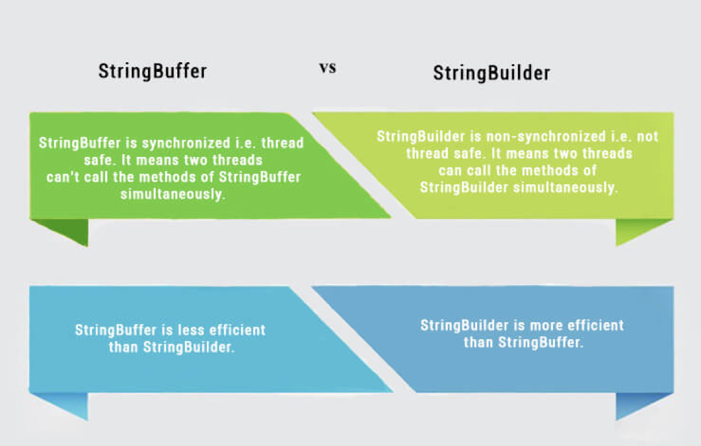
String Builder & String Buffer

Slide 36
Handson topics/details
https://www.codesdope.com/practice/java-characters-and-string/
https://www.java67.com/2018/04/21-string-programming-and-coding-interview-questions-answers.html

Slide 37
Reference Links
https://study.com/academy/lesson/java-string-constant-pool-concept-mechanism.html
https://www.javatpoint.com/java-string
https://www.youtube.com/watch?v=UKG1xgh_tbQ
https://www.youtube.com/watch?v=47-kDKPWBBM
https://www.youtube.com/watch?v=ZhQxRyyqiI8

Slide 38
Day - 5
Arrays, Map and Collections

Slide 39
Arrays, Map and Collections
Arrays, Map and Collections
Java Collections Framework
Initialising an Array in Java

Slide 40
Arrays, Map and Collections
Arrays, Map and Collections
Java Collections Framework
Initialising an Array in Java

Slide 41
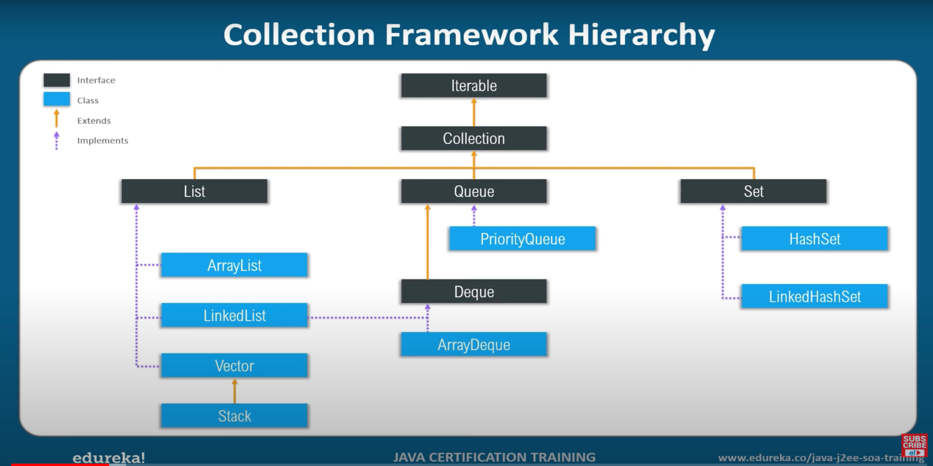
Notes:
https://www.vogella.com/tutorials/JavaCollections/article.html

Slide 42
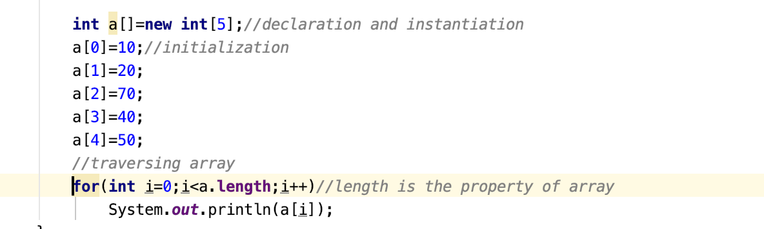
Initialising an Array in Java
Notes:
https://www.geeksforgeeks.org/iterators-in-java/

Slide 43
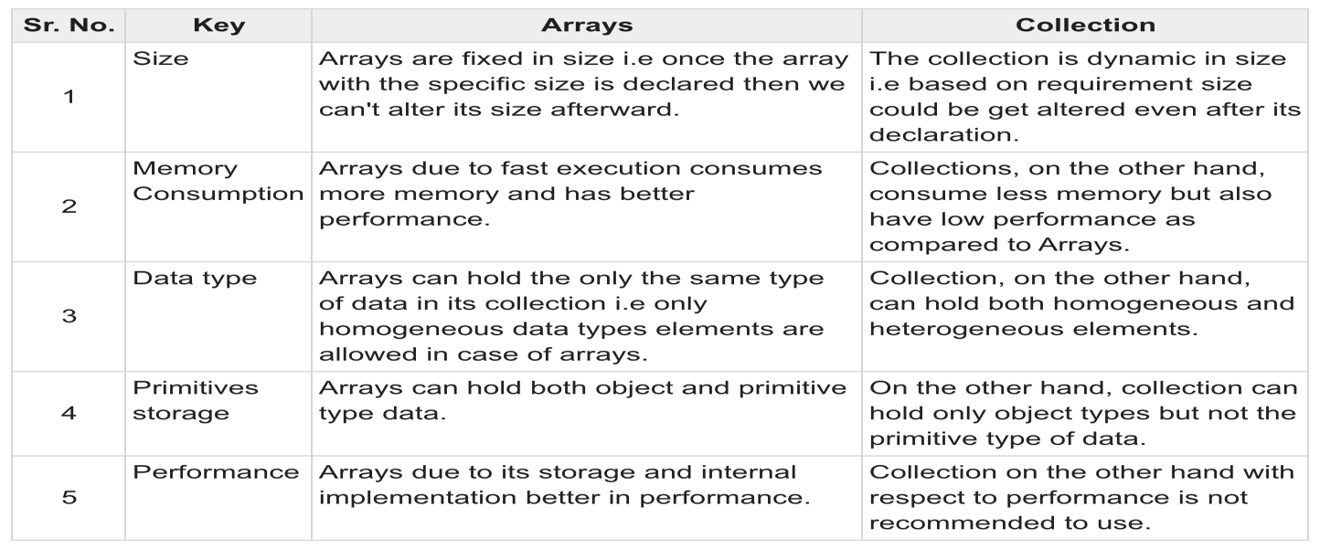
Arrays, Map and Collections
Arrays : An array is a container object that holds a fixed number of values of a single type.
Map & Collection : The Collection in Java is a framework that provides an architecture to store and manipulate the group of objects. Java Collections can achieve all the operations that you perform on a data such as searching, sorting, insertion, manipulation, and deletion.
A map contains values on the basis of key, i.e. key and value pair. Each key and value pair is known as an entry. A Map contains unique keys

Slide 44
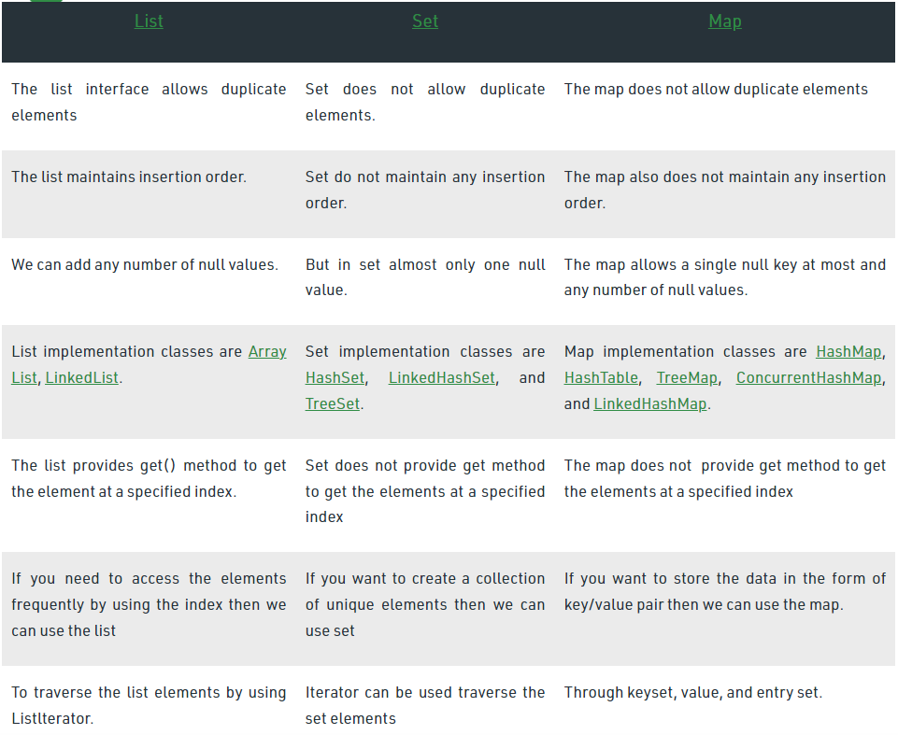

Slide 45
Handson topics/details
https://www.codesdope.com/practice/java-array/
https://www.codesdope.com/practice/java-array-of-objects//practice/java-array-of-objects/
https://www.w3resource.com/java-exercises/collection/index.php

Slide 46
Reference Links
https://www.w3schools.com/java/java_arrays.asp
https://www.vogella.com/tutorials/JavaCollections/article.html

Slide 47
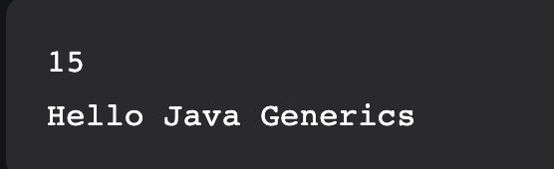
Generics
// A Simple Java program to show working of user defined
// Generic classes
// We use < > to specify Parameter type
class Test<T>
{
// An object of type T is declared
T obj;
Test(T obj) { this.obj = obj; } // constructor
public T getObject() { return this.obj; }
}
// Driver class to test above
class Main
{
public static void main (String[] args)
{
// instance of Integer type
Test <Integer> iObj = new Test<Integer>(15);
System.out.println(iObj.getObject());
// instance of String type
Test <String> sObj =
new Test<String>("Hello Java Generics");
System.out.println(sObj.getObject());
}
}

Slide 48
Day - 6
Generics and Enums

Slide 49
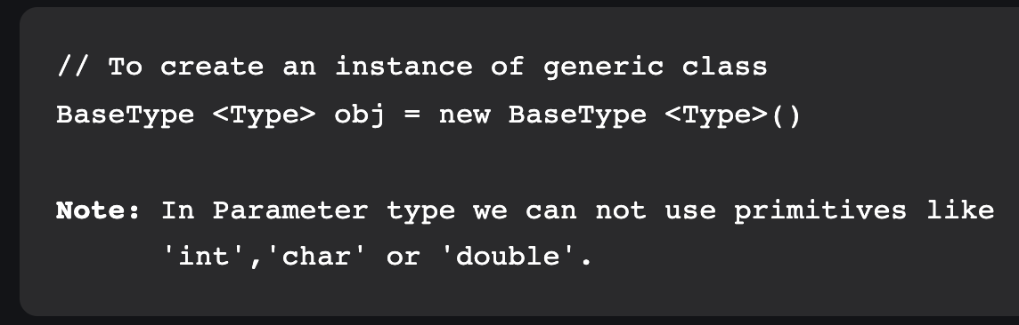
Generics and Enums
Generics
The Java Generics programming is introduced in J2SE 5 to deal with type-safe objects. It makes the code stable by detecting the bugs at compile time.
Before generics, we can store any type of objects in the collection, i.e., non-generic. Now generics force the java programmer to store a specific type of objects.
Generics mean parameterized types. The idea is to allow type (Integer, String, … etc, and user-defined types) to be a parameter to methods, classes, and interfaces. Using Generics, it is possible to create classes that work with different data types.
An entity such as class, interface, or method that operates on a parameterized type is called a generic entity.
HashSet, ArrayList, HashMap, etc use generics very well

Slide 50
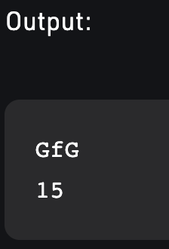
// A Simple Java program to show multiple // type parameters in Java Generics
// We use < > to specify Parameter type
class Test<T, U>
{
T obj1; // An object of type T
U obj2; // An object of type U
// constructor
Test(T obj1, U obj2)
{
this.obj1 = obj1;
this.obj2 = obj2;
}
// To print objects of T and U
public void print()
{
System.out.println(obj1);
System.out.println(obj2);
}
}
// Driver class to test above
class Main
{
public static void main (String[] args)
{
Test <String, Integer> obj =
new Test<String, Integer>("GfG", 15);
obj.print();
}
}

Slide 51
// A Simple Java program to show working of user defined Generic functions
class Test
{
// A Generic method example
static <T> void genericDisplay (T element)
{
System.out.println(element.getClass().getName() +
" = " + element);
}
// Driver method
public static void main(String[] args)
{
// Calling generic method with Integer argument
genericDisplay(11);
// Calling generic method with String argument
genericDisplay("Java Generic Functions");
// Calling generic method with double argument
genericDisplay(1.0);
}
}

Slide 52
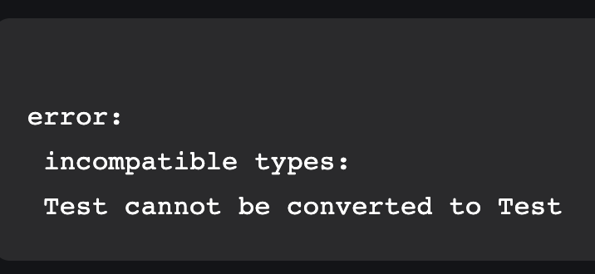
// A Simple Java program to show working of user-defined Generic classes
// We use < > to specify Parameter type
class Test<T>
{
// An object of type T is declared
T obj;
Test(T obj) { this.obj = obj; } // constructor
public T getObject() { return this.obj; }
}
// Driver class to test above
class Main
{
public static void main (String[] args)
{
// instance of Integer type
Test <Integer> iObj = new Test<Integer>(15);
System.out.println(iObj.getObject());
// instance of String type
Test <String> sObj =
new Test<String>("GeeksForGeeks");
System.out.println(sObj.getObject());
iObj = sObj; //This results an error
}
}
Even though iObj and sObj are of type Test, they are the references to different types because their type parameters differ. Generics add type safety through this and prevent errors.

Slide 53
Advantages of Generics
// A Simple Java program to demonstrate that NOT using generics can cause run time exceptions
import java.util.*;
class Test
{
public static void main(String[] args)
{
// Creatinga an ArrayList without any type specified
ArrayList al = new ArrayList();
al.add("Sachin");
al.add("Rahul");
al.add(10); // Compiler allows this
String s1 = (String)al.get(0);
String s2 = (String)al.get(1);
// Causes Runtime Exception
String s3 = (String)al.get(2);
}
}
Exception in thread "main" java.lang.ClassCastException:
java.lang.Integer cannot be cast to java.lang.String
at Test.main(Test.java:19)
1. Code Reuse: We can write a method/class/interface once and use it for any type we want.
2. Type Safety: Generics make errors to appear compile time than at run time (It’s always better to know problems in your code at compile time rather than making your code fail at run time). Suppose you want to create an ArrayList that store name of students and if by mistake programmer adds an integer object instead of a string, the compiler allows it. But, when we retrieve this data from ArrayList, it causes problems at runtime.
3. Individual Type Casting is not needed:
If we do not use generics, then, in the above example every time we retrieve data from ArrayList, we have to typecast it. Typecasting at every retrieval operation is a big headache. If we already know that our list only holds string data then we need not typecast it every time. 4. Generics promotes code reusability.
5. Implementing generic algorithms: By using generics, we can implement algorithms that work on different types of objects and at the same, they are type safe too.

Slide 54
Wildcard in Java Generics
import java.util.*;
abstract class Shape{
abstract void draw();
}
class Rectangle extends Shape{
void draw(){System.out.println("drawing rectangle");}
}
class Circle extends Shape{
void draw(){System.out.println("drawing circle");}
}
class GenericTest{
//creating a method that accepts only child class of Shape
public static void drawShapes(List<? extends Shape> lists){
for(Shape s:lists){
s.draw();//calling method of Shape class by child class instance
} }
public static void main(String args[]){
List<Rectangle> list1=new ArrayList<Rectangle>();
list1.add(new Rectangle());
List<Circle> list2=new ArrayList<Circle>();
list2.add(new Circle());
list2.add(new Circle());
drawShapes(list1);
drawShapes(list2);
}}
The ? (question mark) symbol represents the wildcard element. It means any type. If we write <? extends Number>, it means any child class of Number, e.g., Integer, Float, and double. Now we can call the method of Number class through any child class object.
We can use a wildcard as a type of a parameter, field, return type, or local variable. However, it is not allowed to use a wildcard as a type argument for a generic method invocation, a generic class instance creation, or a supertype.

Slide 55
Unbounded Wildcards Example
import java.util.Arrays;
import java.util.List;
public class UnboundedWildcard {
public static void display(List<?> list)
{
for(Object o:list)
{
System.out.println(o);
}
}
public static void main(String[] args) {
List<Integer> l1=Arrays.asList(1,2,3);
System.out.println("displaying the Integer values");
display(l1);
List<String> l2=Arrays.asList("One","Two","Three");
System.out.println("displaying the String values");
display(l2);
}
}
displaying the Integer values
1
2
3
displaying the String values
One
Two
Three
The unbounded wildcard type represents the list of an unknown type such as List<?>. This approach can be useful in the following scenarios: -
When the given method is implemented by using the functionality provided in the Object class.
When the generic class contains the methods that don't depend on the type parameter.

Slide 56
Lower Bounded Wildcards
public class LowerBoundWildcard {
public static void addNumbers(List<? super Integer> list) {
for(Object n:list)
{
System.out.println(n);
}
}
public static void main(String[] args) {
List<Integer> l1=Arrays.asList(1,2,3);
System.out.println("displaying the Integer values");
addNumbers(l1);
List<Number> l2=Arrays.asList(1.0,2.0,3.0);
System.out.println("displaying the Number values");
addNumbers(l2);
}
}
displaying the Integer values
1
2
3
displaying the Number values
1.0
2.0
3.0
The purpose of lower bounded wildcards is to restrict the unknown type to be a specific type or a supertype of that type. It is used by declaring wildcard character ("?") followed by the super keyword, followed by its lower bound.
List<? super Integer>
? is a wildcard character.
super, is a keyword.
Integer, is a wrapper class.
Suppose, we want to write the method for the list of Integer and its supertype (like Number, Object). Using List<? super Integer> is suitable for a list of type Integer or any of its superclasses whereas List<Integer> works with the list of type Integer only. So, List<? super Integer> is less restrictive than List<Integer>.

Slide 57
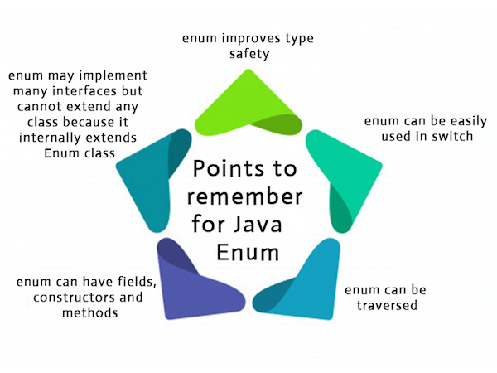
Enums
Enums
The Enum in Java is a data type which contains a fixed set of constants.
Java Enums can be thought of as classes which have a fixed set of constants (a variable that does not change).
The Java enum constants are static and final implicitly.
It is available since JDK 1.5.

Slide 58
Enums Examples
class EnumExample1{
//defining the enum inside the class
public enum Season { WINTER, SPRING, SUMMER, FALL }
//main method
public static void main(String[] args) {
//traversing the enum
for (Season s : Season.values())
System.out.println(s);
}}
WINTER
SPRING
SUMMER
FALL
class EnumExample1{
//defining enum within class
public enum Season { WINTER, SPRING, SUMMER, FALL }
//creating the main method
public static void main(String[] args) {
//printing all enum
for (Season s : Season.values()){
System.out.println(s);
}
System.out.println("Value of WINTER is: "+Season.valueOf("WINTER"));
System.out.println("Index of WINTER is: "+Season.valueOf("WINTER").ordinal());
System.out.println("Index of SUMMER is: "+Season.valueOf("SUMMER").ordinal());
}}
WINTER
SPRING
SUMMER
FALL
Value of WINTER is: WINTER
Index of WINTER is: 0
Index of SUMMER is: 2

Slide 59
Enums
Java compiler internally adds values(), valueOf() and ordinal() methods within the enum at compile time. It internally creates a static and final class for the enum.
purpose of the values() method in the enum
The Java compiler internally adds the values() method when it creates an enum. The values() method returns an array containing all the values of the enum.
purpose of the valueOf() method in the enum
The Java compiler internally adds the valueOf() method when it creates an enum. The valueOf() method returns the value of given constant enum.
purpose of the ordinal() method in the enum
The Java compiler internally adds the ordinal() method when it creates an enum. The ordinal() method returns the index of the enum value.
The enum can be defined within or outside the class because it is similar to a class. The semicolon (;) at the end of the enum constants are optional. For example:
enum Season { WINTER, SPRING, SUMMER, FALL }
Or,
enum Season { WINTER, SPRING, SUMMER, FALL; }
Both the definitions of Java enum are the same.

Slide 60
enum Season{
WINTER(10),SUMMER(20);
private int value;
Season(int value){
this.value=value;
}
}
final class Season extends Enum
{
public static Season[] values()
{
return (Season[])$VALUES.clone();
}
public static Season valueOf(String s)
{
return (Season)Enum.valueOf(Season, s);
}
private Season(String s, int i, int j)
{
super(s, i);
value = j;
}
public static final Season WINTER;
public static final Season SUMMER;
private int value;
private static final Season $VALUES[];
static
{
WINTER = new Season("WINTER", 0, 10);
SUMMER = new Season("SUMMER", 1, 20);
$VALUES = (new Season[] {
WINTER, SUMMER
});
}
}
Constructor of enum type is private. If you don't declare private compiler internally creates private constructor. We cannot create Enum using new Keyword.

Slide 61
Handson topics/details
https://courses.cs.washington.edu/courses/cse341/12au/java/mini1.pdf

Slide 62
Reference Links
https://javarevisited.blogspot.com/2011/09/generics-java-example-tutorial.html
https://docs.oracle.com/javase/tutorial/java/generics/types.html
https://www.geeksforgeeks.org/generics-in-java/
https://www.javatpoint.com/enum-in-java

Slide 63
Day - 7
Exception Handling

Slide 64
Exception Handling
Overview of Exception Handling
Types of Exception
Exceptions Hierarchy
Building blocks of Exception Handling
MultiCatch
Finally Block
Exception Handling Example

Slide 65
Overview of Exception Handling
Exception are anomalies or unusual conditions that a java program may encounter during execution.
Flow of exception Handling should be :
If there is any possibility of such unusual conditions then add throws declaration on that method
Found an anomaly or unusual condition then throw an exception
For exception handling, catch exception and complete processing then throw exception with or without manipulation again if its required

Slide 66
Types of Exception
Checked Exception
These are the exceptions that are checked at compile time. If some code within a method throws a checked exception, then the method must either handle the exception or it must specify the exception using the throws keyword.
Ex: IOException, InterruptedException
Inherited from java.lang.Exception.java
Unchecked Exception
These are the exceptions that are not checked at compile time.
It is not forced by the compiler to either handle or specify the exception.
Ex: ArithmeticException, NullPointerException
In Java, exceptions under Error and RuntimeException classes are unchecked exceptions, everything else under throwable is checked.

Slide 67
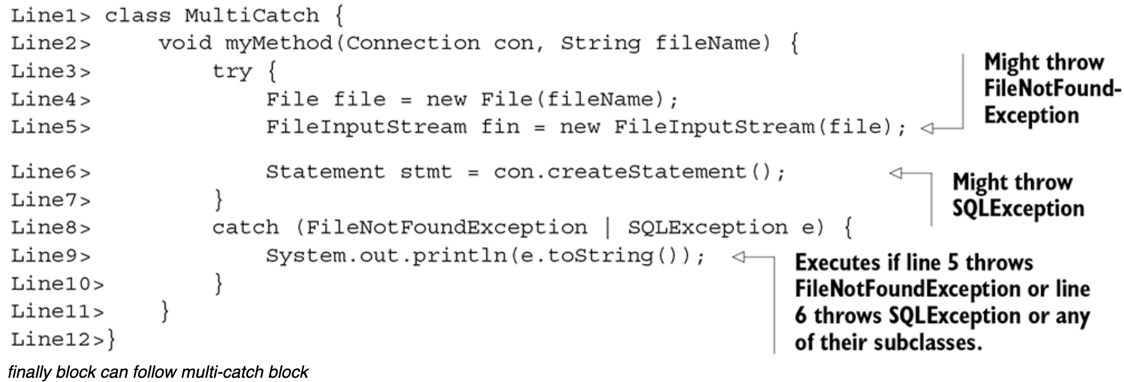
MultiCatch

Slide 68
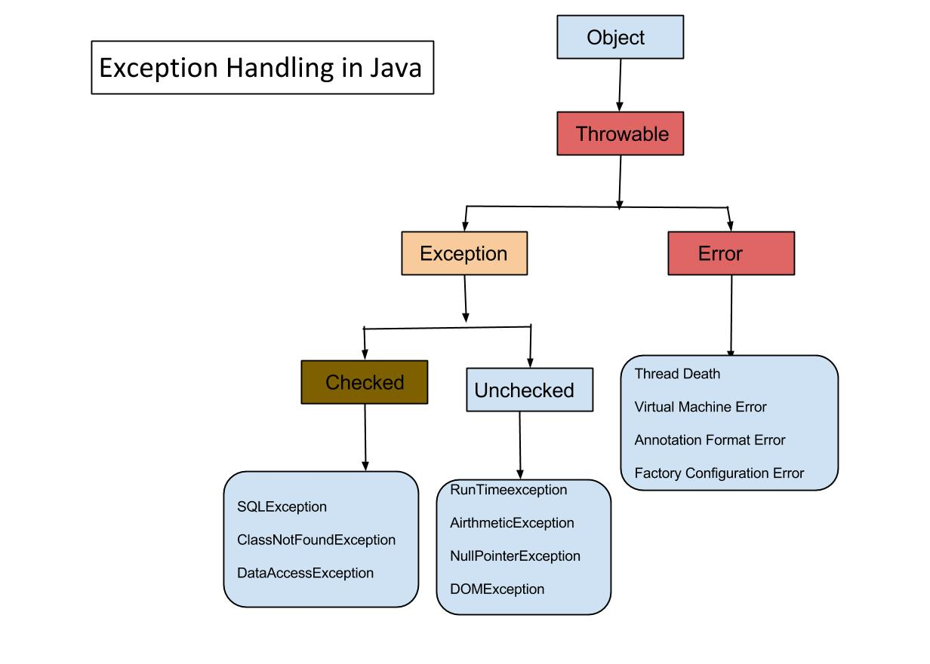
Exceptions Hierarchy

Slide 69
Building blocks of Exception Handling
try - Block where execution happens
catch - Block where exceptions are handled
throw - Used to throw exception in execution flow
throws - Used to indicate which exceptions can be encountered
void somemethod() throws Exception
try {
… normal program code
throw new Exception();
}
catch(Exception e) {
… exception handling code
}

Slide 70
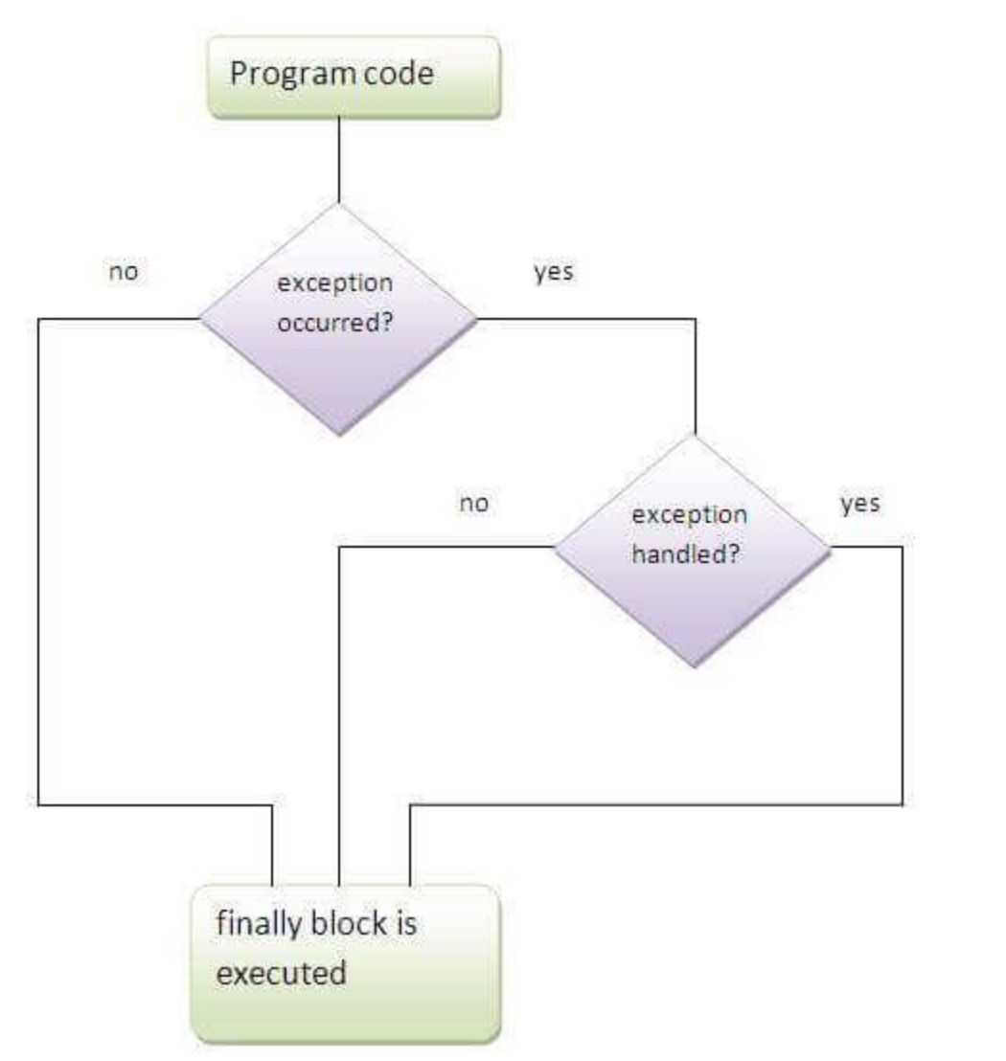
Finally Block
finally block is a block that is used to execute important code such as closing connection, stream etc.
finally block is always executed whether exception is handled or not.
finally block follows try or catch block.

Slide 71
Handson topics/details
https://courses.cs.washington.edu/courses/cse341/12au/java/mini1.pdf
Catch a runtime exception - divide a number by zero
Add a readList method to ListOfNumbers.java (in a .java source file). This method should read in int values from a file, print each value, and append them to the end of the vector. You should catch all appropriate errors. You will also need a text file containing numbers to read in.
Keeping the above, Create your own exception
Create your own exception class hierarchy
Keeping problem statement 2 in mind catch an exception and throw different exception

Slide 72
Exception Handling Example
/ /This method reads a string from the keyboard
public String input() throws MyException { // Use throws to warn
// that the method may throw a MyException
BufferedReader reader = new BufferedReader(new InputStreamReader(System.in));
String s = null;
// We use a try block to wrap code that might create an exception. In this case,
// the compiler tells us that the readLine() method in the
// BufferedReader class might throw an I/O exception
try {
s = reader.readLine();
// We use a catch block to wrap the code that handles an IOException
} catch (IOException e) {
System.out.println(e.getMessage());
// We close the read stream in the finally block
} finally {
// An exception might occur when we close the stream if, for example, the stream was not open, so we wrap the code in a try block
try {
reader.close();
// Handle exceptions when closing the read stream
} catch (IOException e) {
System.out.println(e.getMessage());
}
}

Slide 73
Reference Links
https://www.javatpoint.com/exception-handling-in-java
https://www.javatpoint.com/finally-block-in-exception-handling
https://www.javatpoint.com/custom-exception

Slide 74
Day - 8
IO Operations

Slide 75
IO Operations
Input/Output Streams
File Read and Write

Slide 76
Java Input/Output
Java I/O (Input and Output) is used to process the input and produce the output.
Java uses the concept of a stream to make I/O operation fast. The java.io package contains all the classes required for input and output operations.
We can perform file handling in Java by Java I/O API.

Slide 77
Stream
A stream is a sequence of data. In Java, a stream is composed of bytes. It's called a stream because it is like a stream of water that continues to flow.
In Java, 3 streams are created for us automatically. All these streams are attached with the console.
1) System.out: standard output stream
2) System.in: standard input stream
3) System.err: standard error stream

Slide 78
Input / Output Stream
Input Stream
Java application uses an input stream to read data from a source; it may be a file, an array, peripheral device or socket.
Output Stream
Java application uses an output stream to write data to a destination; it may be a file, an array, peripheral device or socket.

Slide 79
Stream
Let's see the code to print output and an error message to the console.
System.out.println("simple message");
System.err.println("error message");
Let's see the code to get input from console
int i=System.in.read(); //returns ASCII code of 1st character
System.out.println((char)i); //will print the character

Slide 80
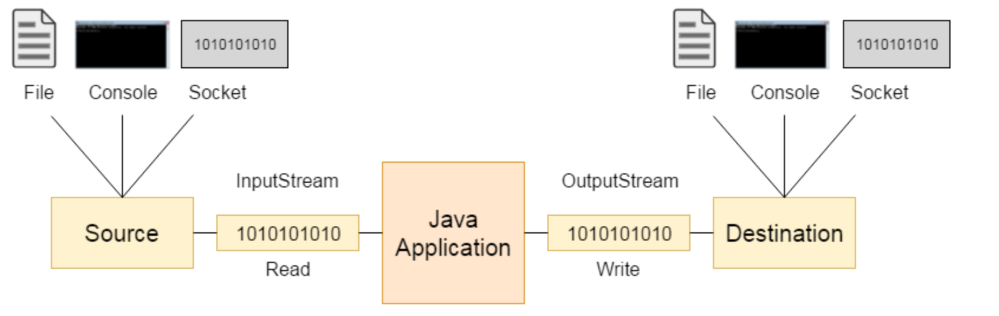
Input / Output Stream

Slide 81
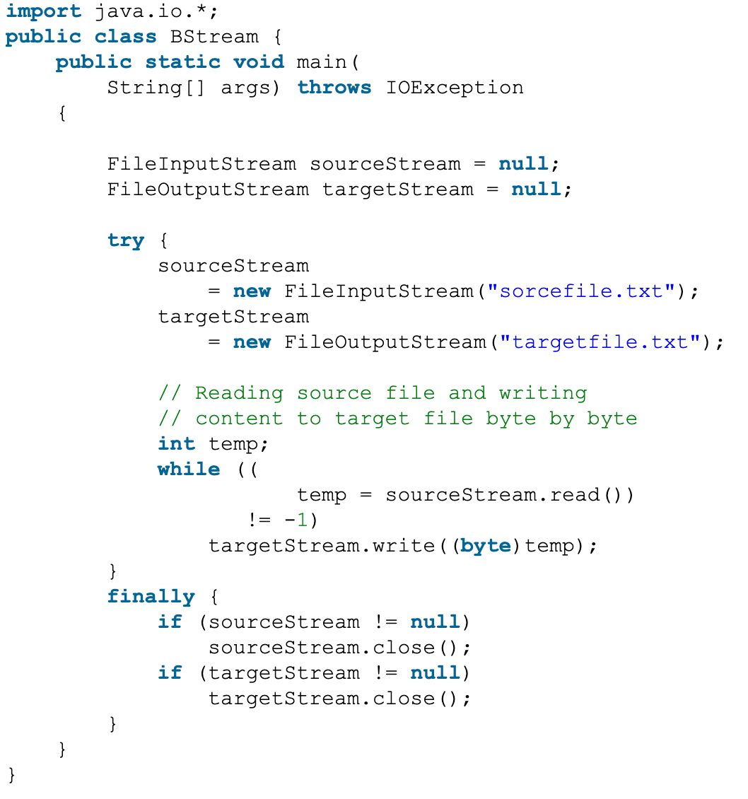
Input / Output Stream
Code to copy content of one file to another

Slide 82
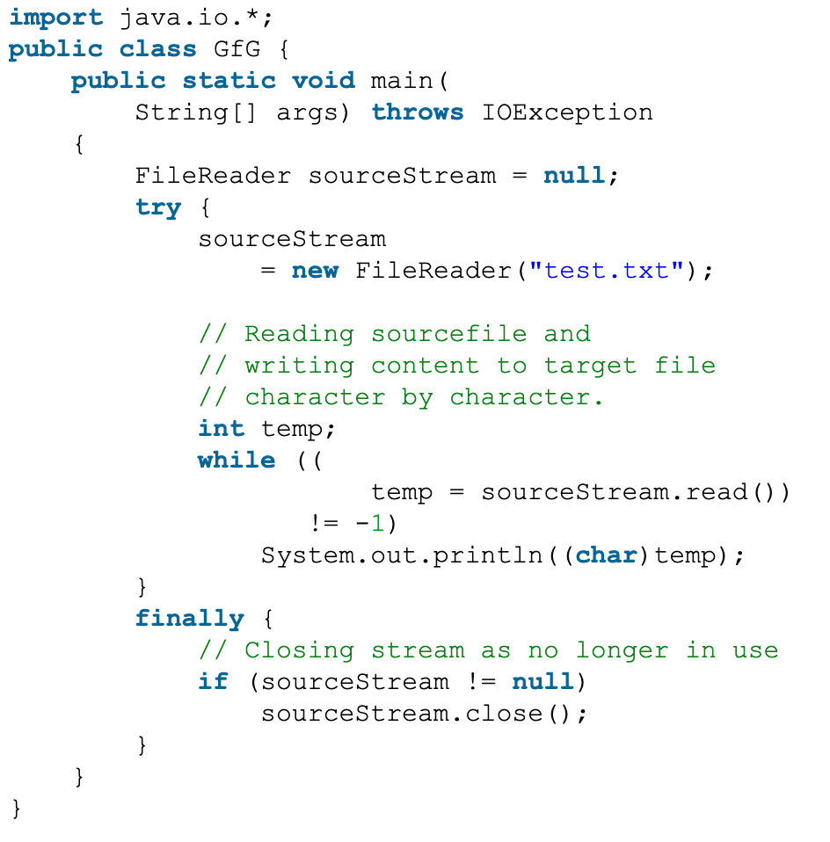
Input / Output Stream
Code to read a file using File Reader

Slide 83
Handson topics/details
Generate CSV file from DAT file from the directory :
https://drive.google.com/drive/folders/12R1Ozkh_-VX8CnmBOSsLL6WHYeJkCrxV?usp=sharing
(Note : Focus on data transfer from DAT file to CSV, rest of things are for experienced developers)

Slide 84
Reference Links
https://www.codesdope.com/java-file-io/

Slide 85
Day - 9
Threading Concepts

Slide 86
Threading Concepts
Thread Lifecycle
Ways to create threads
Synchronised keyword
Inter-thread communication - Wait, Join, notify, notifyAll methods

Slide 87
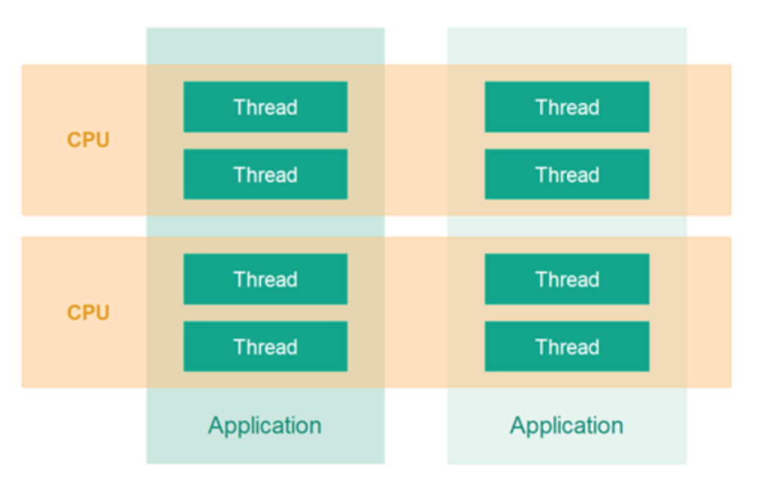
Threading Concepts
What is multithreading?
a process of executing two or more threads simultaneously
Advantages:
Better Utilization of a Single CPU
Better Utilization of Multiple CPUs or CPU Cores
Better User Experience with Regards to Responsiveness
Better User Experience with Regards to Fairness

Slide 88
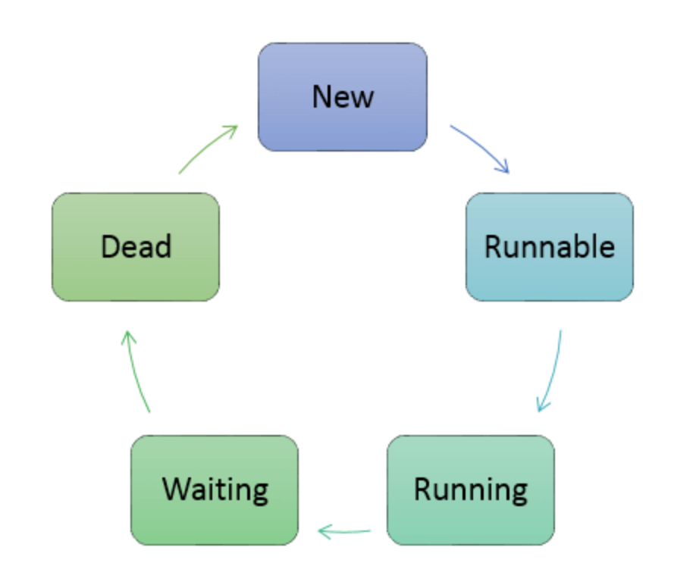
Thread Life Cycle
New: The thread is created using class "Thread". It remains in this state till the program starts the thread.
Runnable: The instance of the thread is invoked with a start method. The thread control is given to scheduler to finish the execution, but the thread is not running.
Running: When the scheduler starts executing a thread, then the state is changed to "running" state.
Waiting: When a thread has to wait.
Dead: When the thread completes the execution.

Slide 89
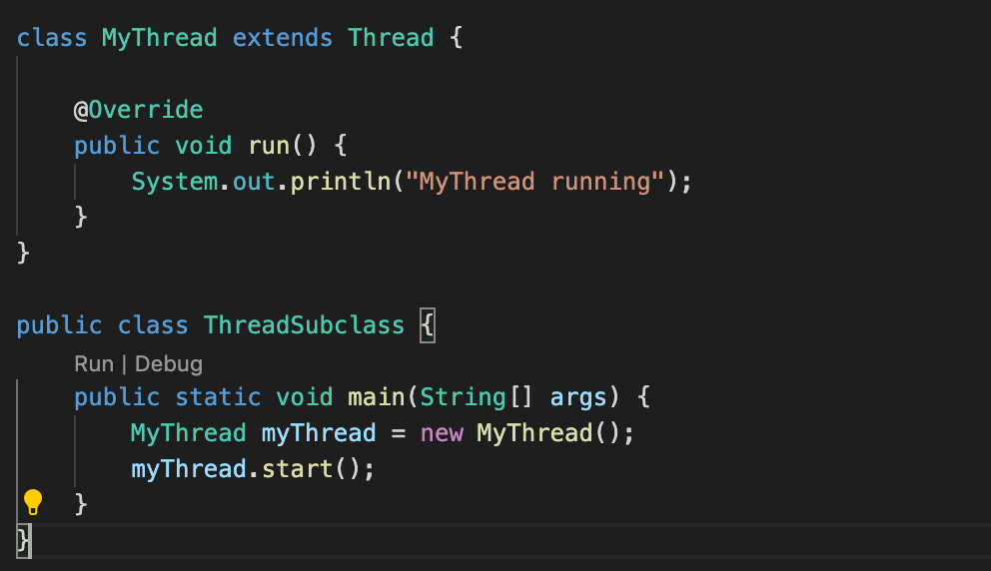
Ways to Create Thread
Thread class provide constructors and methods to create and perform operations on a thread.Thread class extends Object class and implements Runnable interface.
Commonly used Constructors of Thread class:
Thread()
Thread(String name)
Thread(Runnable r)
Thread(Runnable r,String name)
Thread Subclass

Slide 90
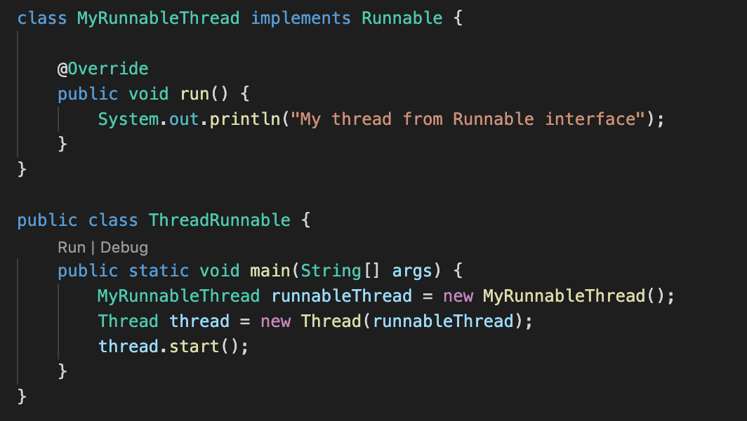
Ways to Create Thread
Runnable Interface
The Runnable interface should be implemented by any class whose instances are intended to be executed by a thread. Runnable interface have only one method named run().
public void run(): is used to perform action for a thread.

Slide 91
Ways to Create Thread
Using the Thread Class: Thread(Runnable r, String name)
public class MyThread2 implements Runnable {
public void run() {
System.out.println("Now the thread is running ...");
}
// main method
public static void main(String argvs[])
{
Runnable r1 = new MyThread2(); // creating an object of the class MyThread2
// creating an object of the class Thread using Thread(Runnable r, String name)
Thread th1 = new Thread(r1, "My new thread");
th1.start(); // the start() method moves the thread to the active state
String str = th1.getName(); // getting the thread name by invoking the getName() method
System.out.println(str);
}
}

Slide 92
Race Condition
It occurs in a multi-threaded environment when more than one thread try to access a shared resource (modify, write) at the same time
It is safe if multiple threads are trying to read a shared resource as long as they are not trying to change it.
The problem arises when these threads try to access the same resource.
Examples of shared resources are class variables, DB record in a table, writing in a file.

Slide 93
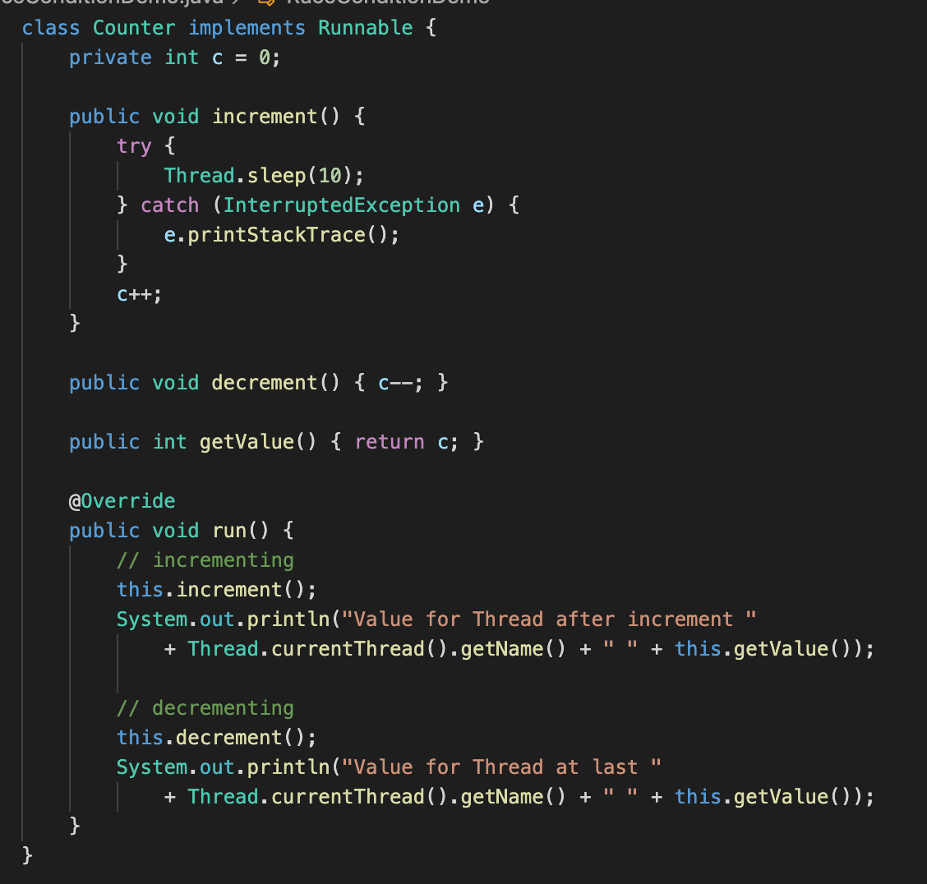
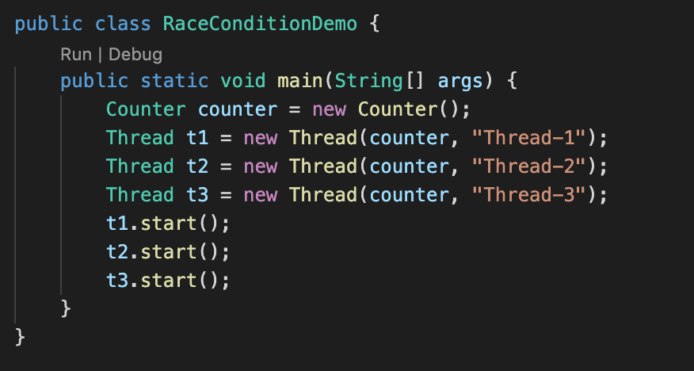
Race Condition Example

Slide 94
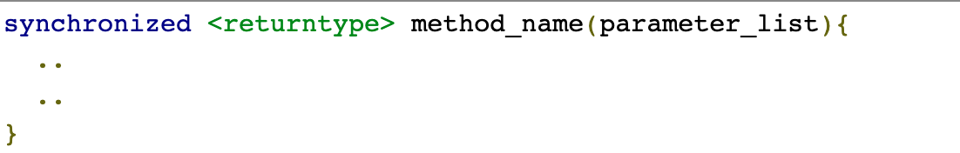
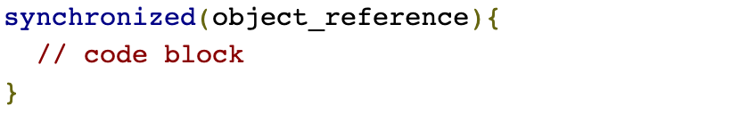
Avoiding Race Conditions
Ensure only one thread can access the shared resource at a time
The above process is called synchronization
The concept of monitor is used to achieve synchronization
Every object created in Java has one associated monitor
Java provides two synchronization idioms

Slide 95
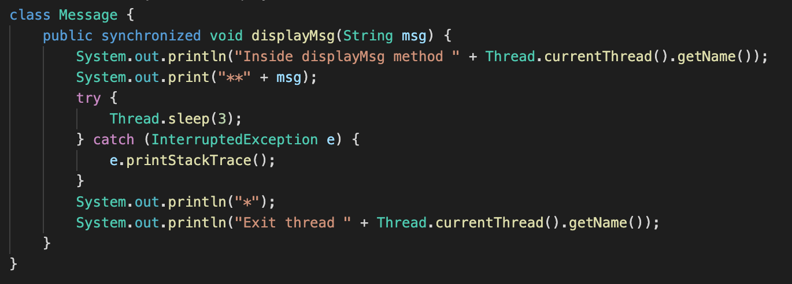
Synchronized Examples
Synchronized method example

Slide 96
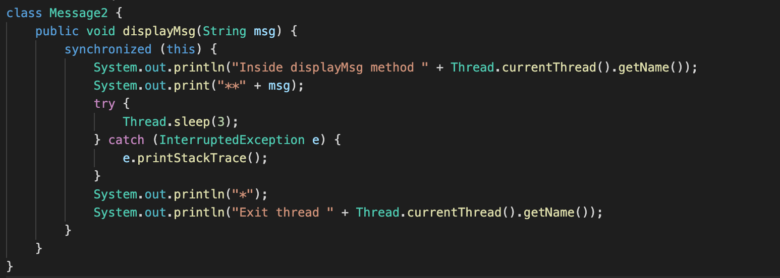
Synchronized Examples
Synchronized block example

Slide 97
Inter-thread communication
Producer-Consumer problem demo
wait(): method tells the current thread to give up monitor and go to sleep, until another thread invokes the notify() or notifyAll() method for this object.
notify(): wakes up a single thread that is waiting on this object's monitor
notifyAll(): wakes up all the threads that called wait() on the same object.
wait(), notify() and notifyAll() methods can only be called from a synchronized context, as these methods are about releasing the monitor and acquiring it.
Producer-Consumer solution demo

Slide 98
Other thread methods
isAlive(): It tests if the thread it is called upon is alive or not. A thread is alive if it has been started and not yet terminated.
join(): It waits until the thread on which it is called terminates. There are three overloaded join methods.
join() - Waits indefinitely for this thread to die.
join(long millis) - Waits at most millis milliseconds for this thread to die. A timeout of 0 means to wait forever.
join(long millis, int nanos) - Waits at most millis milliseconds plus nanos nanoseconds for this thread to die.

Slide 99
Handson topics/details
Create thread through different ways
Read two separate files from individual threads
Create three threads and each should print current date 10 times with 100 ms interval
Try examples for synchronised method, block and understand its' effect
Fix the race condition example
Print chat like conversation which maintains order of questions and answers. One thread should print only questions and the second thread should print only answers

Slide 100
Java 8+ Features
Lambda Expression
Functional Interface
Stream API
Date/Time new features
Optional
To touch base on the new features
Java 9 Features

Slide 101
Reference Links
https://www.javatpoint.com/multithreading-in-java
http://tutorials.jenkov.com/java-concurrency/index.html
https://www.youtube.com/watch?v=TCd8QIS-2KI
https://www.netjstech.com/2015/06/race-condition-in-java-multi-threading.html
https://www.netjstech.com/2015/06/synchronization-in-java-multithreading-synchronizing-thread.html
https://www.netjstech.com/2015/07/inter-thread-communiction-wait-notify-java-multi-thread.html
https://www.netjstech.com/2015/07/why-wait-notify-and-notifyall-methods-in-object-class-java-multi-threading.html
https://www.netjstech.com/2015/06/isalive-and-join-method-in-java-multi.html

Slide 102
Day - 10
Java 8+ Features

Slide 103
Lambda Expression : Java8
It provides a clear and concise way to represent one method interface using an expression. It is very useful in collection library. It helps to iterate, filter and extract data from collection. The Lambda expression is used to provide the implementation of an interface which has functional interface. It saves a lot of code. In case of lambda expression, we don't need to define the method again for providing the implementation. Here, we just write the implementation code.
Java lambda expression is treated as a function, so compiler does not create .class file. Main Usage is : To provide the implementation of Functional interface and Less coding.
Java Lambda Expression Syntax
(argument-list) -> {body}
1) Argument-list: It can be empty or non-empty as well.
2) Arrow-token: It is used to link arguments-list and body of expression.
3) Body: It contains expressions and statements for lambda expression.

Slide 104
Without Lambda Expression
interface Drawable{
public void draw();
}
public class LambdaExpressionExample {
public static void main(String[] args) {
int width=10;
//without lambda, Drawable implementation using anonymous class
Drawable d=new Drawable(){
public void draw(){System.out.println("Drawing "+width);}
};
d.draw();
}
}
Java Lambda Expression Example
@FunctionalInterface //It is optional
interface Drawable{
public void draw();
}
public class LambdaExpressionExample2 {
public static void main(String[] args) {
int width=10;
//with lambda
Drawable d2=()->{
System.out.println("Drawing "+width);
};
d2.draw();
}
}

Slide 105
Java Lambda Expression Example: No Parameter
interface Sayable{
public String say();
}
public class LambdaExpressionExample3{
public static void main(String[] args) {
Sayable s=()->{
return "I have nothing to say.";
};
System.out.println(s.say());
}
}
Java Lambda Expression Example: Single Parameter
interface Sayable{
public String say(String name);
}
public class LambdaExpressionExample4{
public static void main(String[] args) {
// Lambda expression with single parameter.
Sayable s1=(name)->{
return "Hello, "+name;
};
System.out.println(s1.say("Sonoo"));
// You can omit function parentheses
Sayable s2= name ->{
return "Hello, "+name;
};
System.out.println(s2.say("Sonoo"));
}
}

Slide 106
Java Lambda Expression Example: Multiple Parameters
interface Addable{
int add(int a,int b);
}
public class LambdaExpressionExample5{
public static void main(String[] args) {
// Multiple parameters in lambda expression
Addable ad1=(a,b)->(a+b);
System.out.println(ad1.add(10,20));
// Multiple parameters with data type in lambda expression
Addable ad2=(int a,int b)->(a+b);
System.out.println(ad2.add(100,200));
}
}

Slide 107
Java Lambda Expression Example: Creating Thread
Implementing run method by using lambda expression.
public class LambdaExpressionExample9{
public static void main(String[] args) {
//Thread Example without lambda
Runnable r1=new Runnable(){
public void run(){
System.out.println("Thread1 is running...");
}
};
Thread t1=new Thread(r1);
t1.start();
//Thread Example with lambda
Runnable r2=()->{
System.out.println("Thread2 is running...");
};
Thread t2=new Thread(r2);
t2.start();
}
}

Slide 108
Functional Interface
@FunctionalInterface
interface sayable{
void say(String msg); // abstract method
// It can contain any number of Object class methods.
int hashCode();
String toString();
boolean equals(Object obj);
}
public class FunctionalInterfaceExample2 implements sayable{
public void say(String msg){
System.out.println(msg);
}
public static void main(String[] args) {
FunctionalInterfaceExample2 fie = new FunctionalInterfaceExample2();
fie.say("Hello there");
}
}
Lambda expression provides implementation of functional interface. An interface which has only one abstract method is called functional interface. Java provides an annotation @FunctionalInterface, which is used to declare an interface as functional interface. Functional Interface is also known as Single Abstract Method Interfaces or SAM Interfaces. It is a new feature in Java, which helps to achieve functional programming approach.
A functional interface can have methods of object class. See in the following example.

Slide 109
Stream API
java.util.stream.
Consists of classes, interfaces and enum
Allows functional-style operations on the elements.
Stream Features:
Stream does not store elements. It simply conveys elements from a source such as a data structure, an array, or an I/O channel, through a pipeline of computational operations.
Stream is functional in nature. Operations performed on a stream does not modify it's source. For example, filtering a Stream obtained from a collection produces a new Stream without the filtered elements, rather than removing elements from the source collection.
Stream is lazy and evaluates code only when required.
The elements of a stream are only visited once during the life of a stream. Like an Iterator, a new stream must be generated to revisit the same elements of the source.

Slide 110
import java.util.*;
class Product{
int id;
String name;
float price;
public Product(int id, String name, float price) {
this.id = id;
this.name = name;
this.price = price;
}
}
public class JavaStreamExample {
public static void main(String[] args) {
List<Product> productsList = new ArrayList<Product>();
//Adding Products
productsList.add(new Product(1,"HP Laptop",25000f));
productsList.add(new Product(2,"Dell Laptop",30000f));
productsList.add(new Product(3,"Lenevo Laptop",28000f));
productsList.add(new Product(4,"Sony Laptop",28000f));
productsList.add(new Product(5,"Apple Laptop",90000f));
List<Float> productPriceList = new ArrayList<Float>();
for(Product product: productsList){
// filtering data of list
if(product.price<30000){
productPriceList.add(product.price); // adding price to a productPriceList
}
}
System.out.println(productPriceList); // displaying data
}
}
List<Float> productPriceList2 =productsList.stream()
.filter(p -> p.price > 30000)// filtering data
.map(p->p.price) // fetching price
.collect(Collectors.toList()); // collecting as list
System.out.println(productPriceList2);

Slide 111
Optional class
public final class from java.util package
used to deal with NullPointerException in Java application.
It provides methods which are used to check the presence of value for particular variable.
Java Optional Example: If Value is not Present
import java.util.Optional;
public class OptionalExample {
public static void main(String[] args) {
String[] str = new String[10];
Optional<String> checkNull = Optional.ofNullable(str[5]);
if(checkNull.isPresent()){ // check for value is present or not
String lowercaseString = str[5].toLowerCase();
System.out.print(lowercaseString);
}else
System.out.println("string value is not present");
}
}
Output:
string value is not present
Example: Java Program without using Optional
This program terminates abnormally and throws a nullPointerException.
public class OptionalExample {
public static void main(String[] args) {
String[] str = new String[10];
String lowercaseString = str[5].toLowerCase();
System.out.print(lowercaseString);
}
}

Slide 112
Java Default Methods
Create default methods inside the interface.
Default Methods
Defined inside the interface
Tagged with default
non-abstract methods.
You can also define static methods inside the interface. Static methods are used to define utility methods.
Abstract Class vs Java 8 Interface
From Java 8, interface and an abstract class is almost similar The key difference is that we can create constructor in the abstract class.
interface Sayable{
// Default method
default void say(){
System.out.println("Hello, this is default method");
}
// Abstract method
void sayMore(String msg);
}
public class DefaultMethods implements Sayable{
public void sayMore(String msg){ // implementing abstract method
System.out.println(msg);
}
public static void main(String[] args) {
DefaultMethods dm = new DefaultMethods();
dm.say(); // calling default method
dm.sayMore("Work is worship"); // calling abstract method
}
}

Slide 113
To touch base on the new features
Method References
Stream Filter
Base64 Encode Decode
Default Methods
forEach() method
Collectors class
StringJoiner class
Optional class
JavaScript Nashorn
Parallel Array Sort
Type Inference
Parameter Reflection
Type Annotations
JDBC Improvements
Java 7 Features

Slide 114
Java 9 Features
Platform Module System (Project Jigsaw)
Interface Private Methods
Try-With Resources
Anonymous Classes
@SafeVarargs Annotation
Collection Factory Methods
Process API Improvement
New Version-String Scheme
JShell: The Java Shell (REPL)
Control Panel
Stream API Improvement

Slide 115
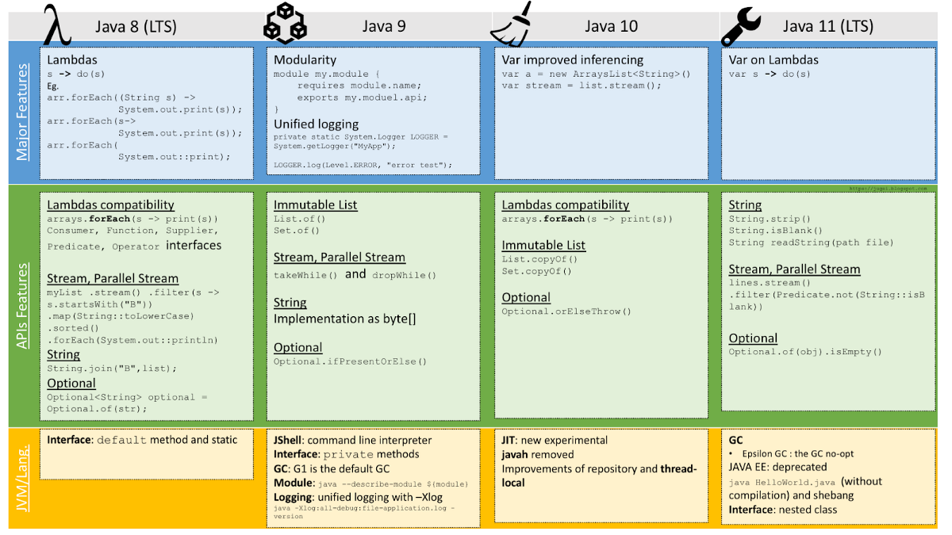
Java 8+ Features

Slide 116
Handson topics/details
learn examples and test various features of all Java 8+ versions

Slide 117
Reference Links
https://www.baeldung.com/java-8-functional-interfaces
https://www.geeksforgeeks.org/functional-interfaces-java/
https://4comprehension.com/busy-developers-guide-to-java-9-10-11-12-13-and-above/
https://dev.to/therajsaxena/java-9-to-java-13-top-features-362l
https://www.javatpoint.com/java-9-features
https://www.journaldev.com/13121/java-9-features-with-examples

Slide 118
Day - 11
Coding Standards

Slide 119
Coding Standards
Introduction
File Names
File Organization
Indentation
Comments
Declarations
Statements
White Space
Naming Conventions
Programming Practices
Code Examples

Slide 120
Introduction
Why Have Code Conventions?
Code conventions are important to programmers for a number of reasons:
80% of the lifetime cost of a piece of software goes to maintenance.
Hardly any software is maintained for its whole life by the original author.
Code conventions improve the readability of the software, allowing engineers to understand new code more quickly and thoroughly.
If you ship your source code as a product, you need to make sure it is as well packaged and clean as any other product you create.

Slide 121
File Names
File Suffixes
Java Software uses the following file suffixes:
Java source= .java
Java bytecode= .class
Common File Names
Frequently used file names include:
GNUmakefile: The preferred name for makefiles. We use gnumake to build our software.
README: The preferred name for the file that summarizes the contents of a particular directory.

Slide 122
File Organization
A file consists of sections that should be separated by blank lines and an optional comment identifying each section.
Files longer than 2000 lines are cumbersome and should be avoided.
Reference for example java program

Slide 123
Java Source Files
Each Java source file contains a single public class or interface. When private classes and interfaces are associated with a public class, you can put them in the same source file as the public class. The public class should be the first class or interface in the file.
Java source files have the following ordering:
Beginning comments
Package and Import statements
Class and interface declarations

Slide 124
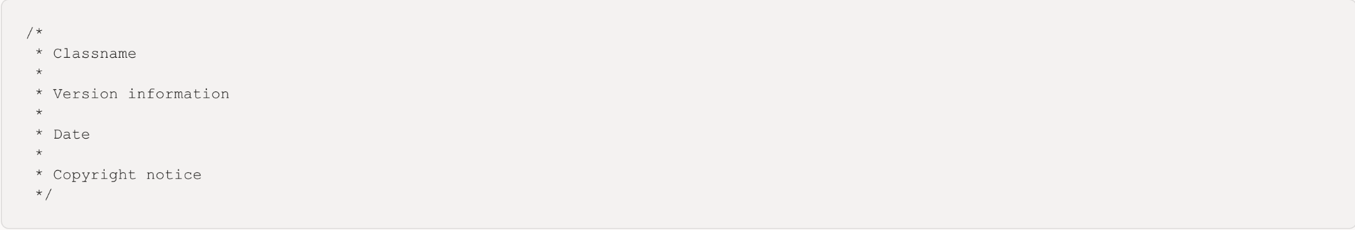
Beginning comments
All source files should begin with a c-style comment that lists the class name, version information, date, and copyright notice:

Slide 125
Package and Import Statements
The first non-comment line of most Java source files is a package statement. After that, import statements can follow. For example:

Slide 126
Indentation
Four spaces should be used as the unit of indentation. The exact construction of the indentation (spaces vs. tabs) is unspecified. Tabs must be set exactly every 8 spaces (not 4).
Line Length
Avoid lines longer than 80 characters, since they're not handled well by many terminals and tools.
Wrapping Lines
When an expression will not fit on a single line, break it according to these general principles:
Break after a comma.
Break before an operator.
Prefer higher-level breaks to lower-level breaks.
Align the new line with the beginning of the expression at the same level on the previous line.
If the above rules lead to confusing code or to code that's squished up against the right margin, just indent 8 spaces instead.

Slide 127
Comments
Java programs can have two kinds of comments: implementation comments and documentation comments. Implementation comments are those found in C++, which are delimited by /*...*/, and //. Documentation comments (known as "doc comments") are Java-only, and are delimited by /**...*/. Doc comments can be extracted to HTML files using the javadoc tool.
Implementation comments are meant for commenting out code or for comments about the particular implementation. Doc comments are meant to describe the specification of the code, from an implementation-free perspective. to be read by developers who might not necessarily have the source code at hand.
Comments should be used to give overviews of code and provide additional information that is not readily available in the code itself. Comments should contain only information that is relevant to reading and understanding the program. For example, information about how the corresponding package is built or in what directory it resides should not be included as a comment.
Discussion of nontrivial or nonobvious design decisions is appropriate, but avoid duplicating information that is present in (and clear from) the code. It is too easy for redundant comments to get out of date. In general, avoid any comments that are likely to get out of date as the code evolves.
Comments should not be enclosed in large boxes drawn with asterisks or other characters.
Comments should never include special characters such as form-feed and backspace.
Note:The frequency of comments sometimes reflects poor quality of code. When you feel compelled to add a comment, consider rewriting the code to make it clearer.

Slide 128
Block Comments
Block comments are used to provide descriptions of files, methods, data structures and algorithms. Block comments may be used at the beginning of each file and before each method. They can also be used in other places, such as within methods. Block comments inside a function or method should be indented to the same level as the code they describe.
/*
* Here is a block comment.
*/
Block comment with Indentation
/*-
* Here is a block comment with some very special
* formatting that I want indent(1) to ignore.
*
* one
* two
* three
*/

Slide 129
Class and Interface Declarations
Part of Class/Interface Declaration | Notes
Class/interface documentation comment ( /**...*/)
class or interface statement
Class/interface implementation comment ( /*...*/), if necessary | This comment should contain any class-wide or interface-wide information that wasn't appropriate for the class/interface documentation comment.
Class ( static) variables | First the public class variables, then the protected, then package level (no access modifier), and then the private.
Instance variables | First public, then protected, then package level (no access modifier), and then private.
Constructors
Methods | These methods should be grouped by functionality rather than by scope or accessibility. For example, a private class method can be in between two public instance methods. The goal is to make reading and understanding the code easier.

Slide 130
Single-Line Comments
Short comments can appear on a single line indented to the level of the code that follows. If a comment can't be written in a single line, it should follow the block comment format. A single-line comment should be preceded by a blank line.
if (condition) {
/* Handle the condition. */
...
}

Slide 131
Trailing Comments
Very short comments can appear on the same line as the code they describe, but should be shifted far enough to separate them from the statements. If more than one short comment appears in a chunk of code, they should all be indented to the same tab setting.
if (a == 2) {
return TRUE; /* special case */
} else {
return isPrime(a); /* works only for odd a */
}

Slide 132
End-Of-Line Comments
The // comment delimiter can comment out a complete line or only a partial line. It shouldn't be used on consecutive multiple lines for text comments; however, it can be used in consecutive multiple lines for commenting out sections of code
if (foo > 1) {
// Do a double-flip.
...
}
else {
return false; // Explain why here.
}
//if (bar > 1) {
//
// // Do a triple-flip.
// ...
//}
//else {
// return false;
//}

Slide 133
Documentation Comments
Doc comments describe Java classes, interfaces, constructors, methods, and fields. Each doc comment is set inside the comment delimiters /**...*/, with one comment per class, interface, or member. This comment should appear just before the declaration:
/**
* The Example class provides ...
*/
public class Example { ...

Slide 134
Declarations
Number Per Line
One declaration per line is recommended since it encourages commenting. In other words,
int level; // indentation level
int size; // size of table
Object currentEntry; // currently selected table entry
Initialization
Try to initialize local variables where they're declared. The only reason not to initialize a variable where it's declared is if the initial value depends on some computation occurring first.
Placement
Put declarations only at the beginning of blocks. (A block is any code surrounded by curly braces "{" and "}".) Don't wait to declare variables until their first use; it can confuse the unwary programmer and hamper code portability within the scope.
void myMethod() {
int int1 = 0; // beginning of method block
if (condition) {
int int2 = 0; // beginning of "if" block
...
}
}
</blockquote>

Slide 135
Class and Interface Declarations
When coding Java classes and interfaces, the following formatting rules should be followed:
No space between a method name and the parenthesis "(" starting its parameter list
Open brace "{" appears at the end of the same line as the declaration statement
Closing brace "}" starts a line by itself indented to match its corresponding opening statement, except when it is a null statement the "}" should appear immediately after the "{"
class Sample extends Object {
int ivar1;
int ivar2;
Sample(int i, int j) {
ivar1 = i;
ivar2 = j;
}
int emptyMethod() {}
...
}

Slide 136
Statements
Simple Statements
Each line should contain at most one statement.
Compound Statements
Compound statements are statements that contain lists of statements enclosed in braces "{ statements }".
The enclosed statements should be indented one more level than the compound statement.
The opening brace should be at the end of the line that begins the compound statement; the closing brace should begin a line and be indented to the beginning of the compound statement.
Braces are used around all statements, even single statements, when they are part of a control structure, such as an if-else or for statement. This makes it easier to add statements without accidentally introducing bugs due to forgetting to add braces.

Slide 137
Statements
return Statements
A return statement with a value should not use parentheses unless they make the return value more obvious in some way.

Slide 138
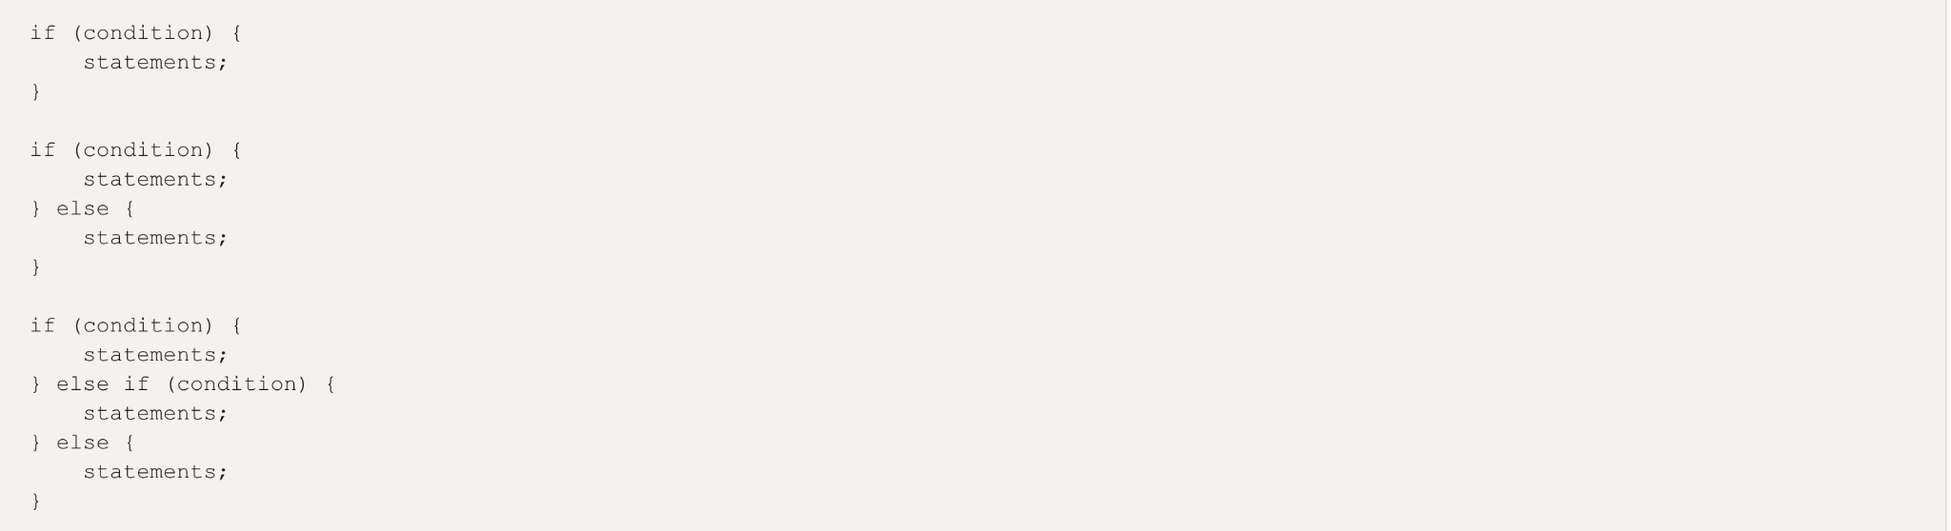
Statements
if, if-else, if else-if else Statements
The if-else class of statements should have the following form:
Note: if statements always use braces, {}. Avoid the following error-prone form:

Slide 139
Statements
for Statements
A for statement should have the following form:
An empty for statement (one in which all the work is done in the initialization, condition, and update clauses) should have the following form:
When using the comma operator in the initialization or update clause of a for statement, avoid the complexity of using more than three variables. If needed, use separate statements before the for loop (for the initialization clause) or at the end of the loop (for the update clause).

Slide 140
Statements
while Statements
A while statement should have the following form:
An empty while statement should have the following form:

Slide 141
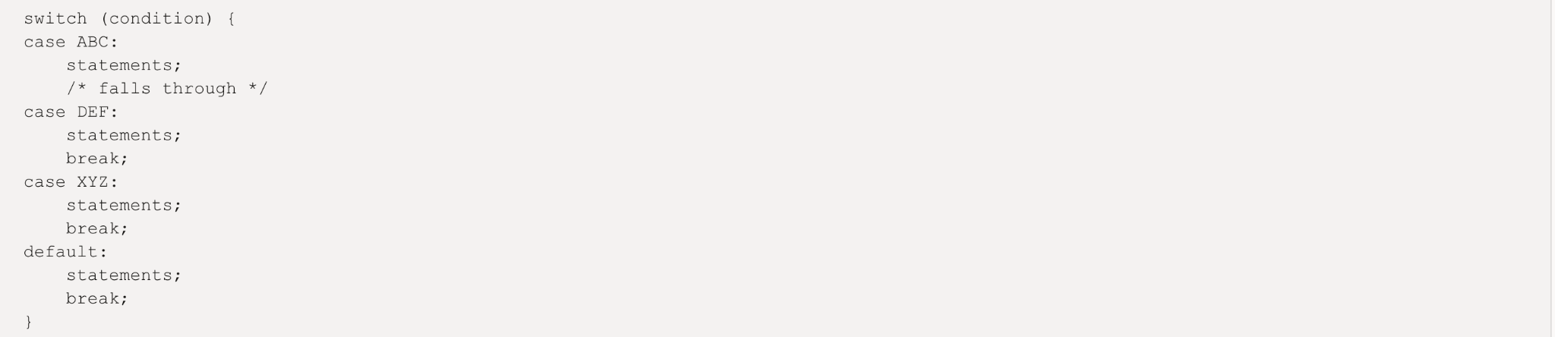
Statements
do-while Statements
A do-while statement should have the following form:
switch Statements
A switch statement should have the following form:

Slide 142
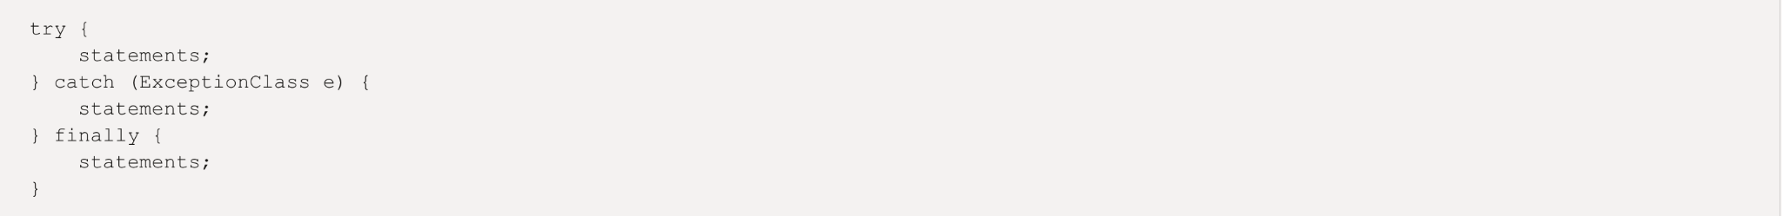
Statements
try-catch Statements
A try-catch statement should have the following format:
A try-catch statement may also be followed by finally, which executes regardless of whether or not the try block has completed successfully.

Slide 143
White Space
Blank Lines
Blank lines improve readability by setting off sections of code that are logically related.
Two blank lines should always be used in the following circumstances:
Between sections of a source file
Between class and interface definitions
One blank line should always be used in the following circumstances:
Between methods
Between the local variables in a method and its first statement
Before a block or single-line comment
Between logical sections inside a method to improve readability
Blank Spaces
Blank spaces should be used in the following circumstances:
A keyword followed by a parenthesis should be separated by a space.

Slide 144
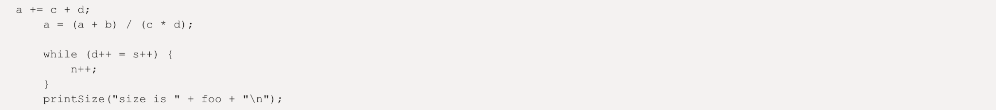
White Space
Note that a blank space should not be used between a method name and its opening parenthesis. This helps to distinguish keywords from method calls.
A blank space should appear after commas in argument lists.
All binary operators except . should be separated from their operands by spaces. Blank spaces should never separate unary operators such as unary minus, increment ("++"), and decrement ("--") from their operands. Example:
The expressions in a for statement should be separated by blank spaces. Example:
for (expr1; expr2; expr3)
Casts should be followed by a blank space. Examples:

Slide 145
Naming Conventions
Naming conventions make programs more understandable by making them easier to read. They can also give information about the function of the identifier-for example, whether it's a constant, package, or class-which can be helpful in understanding the code.
Identifier Type | Rules for Naming | Examples
Packages | The prefix of a unique package name is always written in all-lowercase ASCII letters and should be one of the top-level domain names, currently com, edu, gov, mil, net, org, or one of the English two-letter codes identifying countries as specified in ISO Standard 3166, 1981. Subsequent components of the package name vary according to an organization's own internal naming conventions. Such conventions might specify that certain directory name components be division, department, project, machine, or login names. | com.sun.eng com.apple.quicktime.v2 edu.cmu.cs.bovik.cheese
Classes | Class names should be nouns, in mixed case with the first letter of each internal word capitalized. Try to keep your class names simple and descriptive. Use whole words-avoid acronyms and abbreviations (unless the abbreviation is much more widely used than the long form, such as URL or HTML). | class Raster; class ImageSprite;
Interfaces | Interface names should be capitalized like class names. | interface RasterDelegate; interface Storing;
Methods | Methods should be verbs, in mixed case with the first letter lowercase, with the first letter of each internal word capitalized. | run(); runFast(); getBackground();
Variables | Except for variables, all instance, class, and class constants are in mixed case with a lowercase first letter. Internal words start with capital letters. Variable names should not start with underscore _ or dollar sign $ characters, even though both are allowed. Variable names should be short yet meaningful. The choice of a variable name should be mnemonic- that is, designed to indicate to the casual observer the intent of its use. One-character variable names should be avoided except for temporary "throwaway" variables. Common names for temporary variables are i, j, k, m, and n for integers; c, d, and e for characters. | Copy Copied to Clipboard Error: Could not Copy int i; char c; float myWidth;
Constants | The names of variables declared class constants and of ANSI constants should be all uppercase with words separated by underscores ("_"). (ANSI constants should be avoided, for ease of debugging.) | static final int MIN_WIDTH = 4; static final int MAX_WIDTH = 999; static final int GET_THE_CPU = 1;

Slide 146
Programming Practices
Providing Access to Instance and Class Variables
Don't make any instance or class variable public without good reason. Often, instance variables don't need to be explicitly set or gotten-often that happens as a side effect of method calls.
One example of appropriate public instance variables is the case where the class is essentially a data structure, with no behavior. In other words, if you would have used a struct instead of a class (if Java supported struct), then it's appropriate to make the class's instance variables public.
Referring to Class Variables and Methods
Avoid using an object to access a class (static) variable or method. Use a class name instead.

Slide 147
Programming Practices
Constants
Numerical constants (literals) should not be coded directly, except for -1, 0, and 1, which can appear in a for loop as counter values.
Variable Assignments
Avoid assigning several variables to the same value in a single statement. It is hard to read. Example:
fooBar.fChar = barFoo.lchar = 'c'; // AVOID!
Do not use the assignment operator in a place where it can be easily confused with the equality operator
should be written as
Do not use embedded assignments in an attempt to improve run-time performance. This is the job of the compiler. Example:
d = (a = b + c) + r; // AVOID!
should be written as

Slide 148
Programming Practices
Expressions before `?' in the Conditional Operator
If an expression containing a binary operator appears before the ? in the ternary ?: operator, it should be parenthesized
Special Comments
Use XXX in a comment to flag something that is bogus but works. Use FIXME to flag something that is bogus and broken.

Slide 149
Code Examples
Java Source File Example
Here is the example shows how to format a Java source file containing a single public class. Interfaces are formatted similarly.

Slide 150
Handson topics/details
10 Java Core Best Practices Every Java Programmer Should Know
Create the calculator program with 2 operations: Addition and Subtraction and follow the java best practices and coding standards.

Slide 151
Reference Links
Summery best code practice
Clean code characteristics
Bug free java-code
Name, Comment etc. rule book

Slide 152
Junit

Slide 153
Day - 13
Unit Testing and Junit

Slide 154
Unit Testing and Junit
What is Unit testing
Purpose of the unit tests
Testing terminology
Junit annotations
Assert class
Jar Files for Junit framework
Junit Coding standards

Slide 155
What is Unit testing
A unit test is a way of testing a unit - the smallest piece of code that can be logically isolated in a system.
A unit test is a piece of code written by a developer that executes a specific functionality in the code to be tested and asserts a certain behavior or state.
In most programming languages, that is a function, a subroutine, a method or property.
Generally programmers implement the unit tests

Slide 156
Purpose of the unit tests
To identify software regressions introduced by changes in the source code
It helps the developer to avoid breaking existing code during development activities

Slide 157
Testing terminology
The code which is tested is typically called the code under test. If you are testing an application, this is called the application under test.

Slide 158
Junit annotations
@Test | Identifies a method as a test method.
@Before | Executed before each test. It is used to prepare the test environment (e.g., read input data, initialize the class).
@After | Executed after each test. It is used to cleanup the test environment (e.g., delete temporary data, restore defaults). It can also save memory by cleaning up expensive memory structures.
@BeforeClass | Executed once, before the start of all tests. It is used to perform time intensive activities, for example, to connect to a database. Methods marked with this annotation need to be defined as static to work with JUnit.
@AfterClass | Executed once, after all tests have been finished. It is used to perform clean-up activities, for example, to disconnect from a database. Methods annotated with this annotation need to be defined as static to work with JUnit.
@Ignore or @Ignore("Why disabled") | Marks that the test should be disabled. This is useful when the underlying code has been changed and the test case has not yet been adapted. Or if the execution time of this test is too long to be included. It is best practice to provide the optional description, why the test is disabled.
@Test (expected = Exception.class) | Fails if the method does not throw the named exception.
@Test(timeout=100) | Fails if the method takes longer than 100 milliseconds.

Slide 159
Assert class
The org.junit.Assert class provides methods to assert the program logic.
The common methods of Assert class are as follows:
void assertEquals(boolean expected,boolean actual): checks that two primitives/objects are equal. It is overloaded.
void assertTrue(boolean condition): checks that a condition is true.
void assertFalse(boolean condition): checks that a condition is false.
void assertNull(Object obj): checks that object is null.
void assertNotNull(Object obj): checks that object is not null.

Slide 160
Jar Files for Junit framework
You need to load junit4.jar and hamcrest-core.jar files in your IDE in order to use the annotations and assert class methods. Click here/here to download the required jar files.

Slide 161
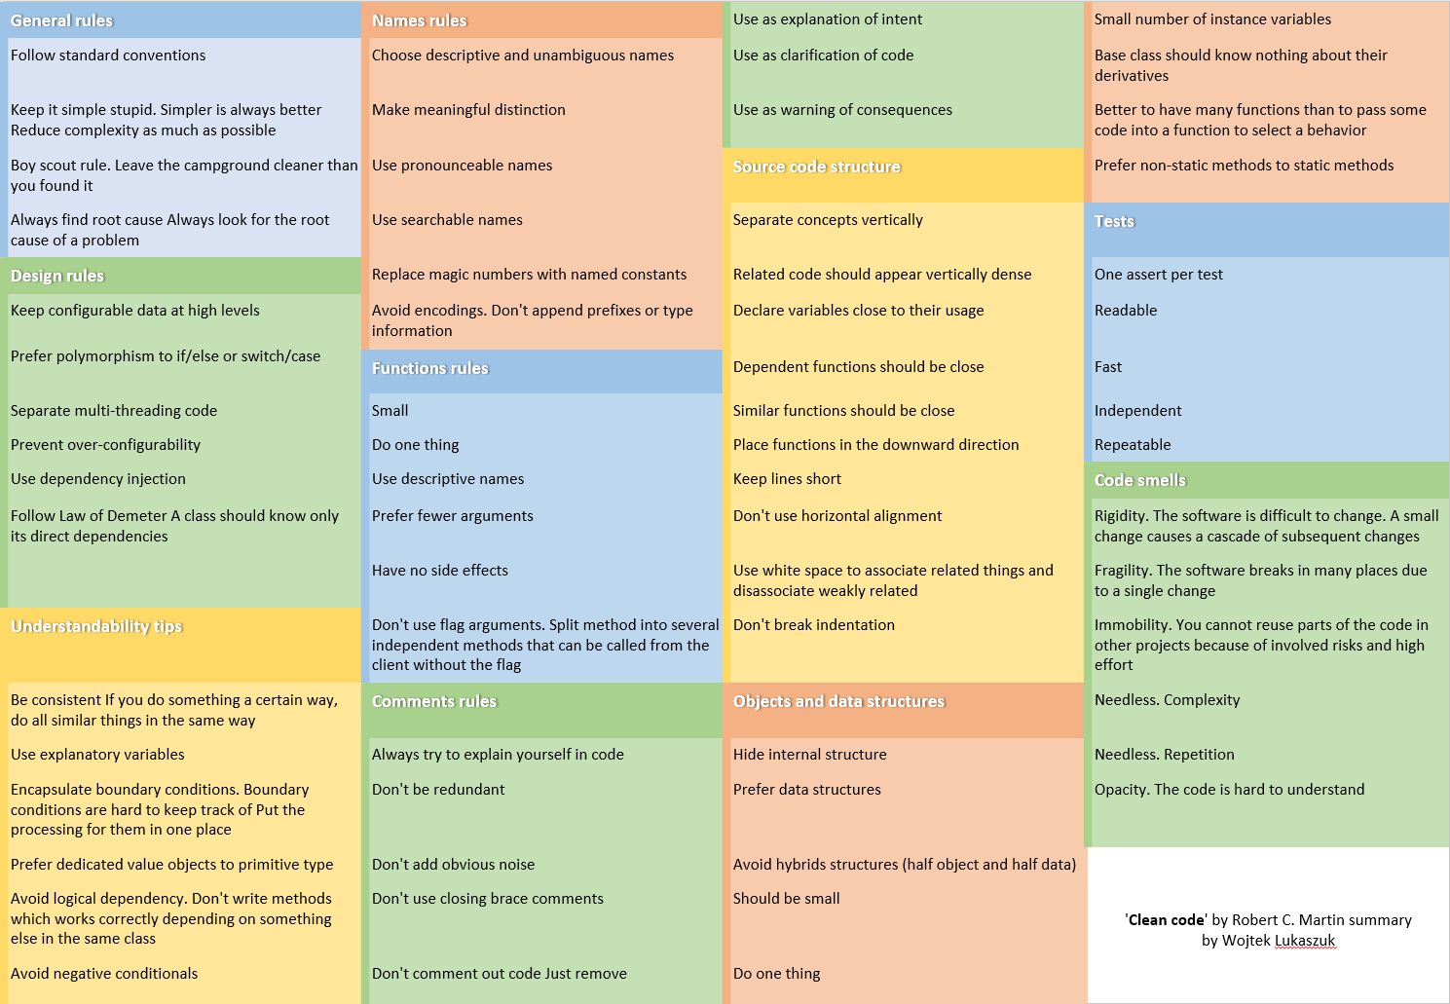
Junit Coding standards

Slide 162
Handson topics/details
https://10.0.1.212:8443/download/attachments/168337085/Junit.zip?version=1&modificationDate=1637564912631&api=v2
Import the above attached Junit.zip project into the eclipse.
Add Testcases (positive and negative) for all the methods present in Helper.java
Cover all the methods and conditions as part of code coverage

Slide 163
Reference Links
https://www.tutorialspoint.com/junit/index.htm
https://www.youtube.com/watch?v=o5k9NOR9lrI
https://www.javatpoint.com/junit-tutorial
https://dzone.com/articles/junit-tutorial-beginners
JUnit Best Practices

Slide 164
Day - 14
Mockito Framework

Slide 165
Mockito Framework
What is Mockito Framework
Adding Mockito to Project
Mockito Important Methods
Limitation of Mockito Framework

Slide 166
What is Mockito Framework
Java based Mocking framework
Mockito is used to mock interfaces/Classes so that a dummy functionality can be added to a mock interface/class that can be used in unit testing
Mocking: Mocking is a way to test the functionality of a class in isolation
Mock objects do the mocking of the real service.
Mock object is a dummy implementation for an interface or a class

Slide 167
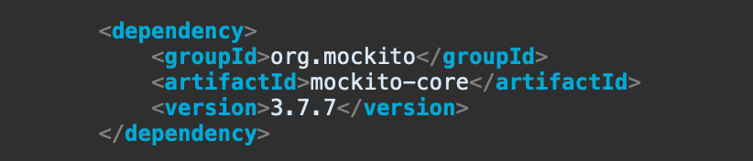
Adding Mockito to a project

Slide 168
Mockito Important Methods
mock() , @mock
when()
thenReturn()
thenThrow()
verify()
spy()
Notes:
Spy: The difference is that in mock, you are creating a complete mock or fake object while in spy, there is the real object and you just spying or stubbing specific methods of it.

Slide 169
Limitation of Mockito Framework
In Mockito Framework, we can not mock static, final and private methods.
PowerMockito is an extension API to support Mockito.
Power Mockito provides capabilities to work with the Java Reflection API in a simple way to overcome the problems.
Avoid PowerMockito as much as possible.

Slide 170
Handson topics/details
Import the attached mockitosample.zip project into the eclipse.
Write testcases for AuthenticatorApplication class in the handson package.

Slide 171
Reference Links
https://www.vogella.com/tutorials/Mockito/article.html
https://www.tutorialspoint.com/mockito/index.htm
https://www.baeldung.com/mockito-series

Slide 172
Java Automation

Slide 173
Day - 15
Introduction to Automation

Slide 174
Introduction to Automation
What is Automation?
Why Automation?
What to Automate?
What not to automate?
What is Selenium?

Slide 175
What is Automation?
Automation Testing or Test Automation is a software testing technique that is performed using special automated testing software tools to execute a test case suite.
Phases of Automation Testing
Test Tool Selection
Define scope of Automation
Planning, Design and Development
Test Execution
Maintenance

Slide 176

Why Automation?

Slide 177

Why Automation?

Slide 178

Why Automation?

Slide 179
What to Automate?
Ones to be run on every build/release (Sanity/Smoke)
Having same workflow different data
Load / Stress testing
Ones taking long time to run
Involve large data as inputs
Require to be tested on multiple set of environments
Need to capture images/reports on each level of execution

Slide 180

What is Selenium?
Selenium is an open-source tool that is used for automating the tests carried out on web browsers.
Pros:
Open Source
Supports Parallel Execution
Supports different frameworks(TestNG, JUNIT, Cucumber)

Slide 181
What not to Automate?
User experience tests for usability
Tests that you will only run one-time.
Test that need to run ASAP
Tests without predictable results
Test that cannot be 100% automated should not be automated at all — unless doing so will save a considerable amount of time.
Test Cases for which the requirements are frequently changing

Slide 182
What is Selenium?
Cons:
We can use Selenium only to test web applications.
It is not possible to perform testing on images.
There is no native reporting facility.
Only User Community Support is available

Slide 183
Reference Links
https://www.perfecto.io/blog/what-is-test-automation
https://blog.vsoftconsulting.com/blog/open-source-vs-commercial-test-automation-tools
https://www.indiumsoftware.com/blog/selenium-test-automation/#:~:text=Selenium%20has%20a%20large%20and,choice%20for%20many%20testing%20projects.
https://www.javatpoint.com/selenium-webdriver
https://www.javatpoint.com/selenium-webdriver-installation
https://www.javatpoint.com/selenium-grid
https://www.javatpoint.com/selenium-ide

Slide 184
Day - 16
Selenium Basics

Slide 185
Selenium Basics
Introduction to Selenium
Selenium IDE
Limitations of Selenium
Selenium Grid
Selenium Webdriver
Setup and Installation

Slide 186
Handson topics/details
Setup environment for selenium WebDriver

Slide 187

Introduction to Selenium

Slide 188
Selenium IDE
Selenium IDE (Integrated Development Environment) is the major tool in the Selenium Suite.
It is a complete integrated development environment (IDE) for Selenium tests.
It is implemented as a Firefox Add-On and as a Chrome Extension.
It allows for recording, editing and debugging of functional tests.
It was previously known as Selenium Recorder.
Below is the link to add IDE to chrome https://chrome.google.com/webstore/detail/selenium-ide/mooikfkahbdckldjjndioackbalphokd?hl=en

Slide 189
Limitations of Selenium IDE
Not suitable for testing huge volume of data
Incapable of handling multiple windows
Connections with the database can not be tested
Does not support capturing of screenshots on test failures
No feature available for generating result reports

Slide 190
Selenium Grid
Selenium Grid is a component in Selenium that allows us to run test cases in different machines across different platforms.
It supports distributed test execution.
When we have multiple test cases, and it's not possible to run all the test cases in the same machine.
We have multiple servers, so local machine distributes the test cases across different machines/servers.

Slide 191

Selenium Grid

Slide 192
Selenium Grid
Hub
A Hub is a central point or a local machine that receives all the test requests and distributes them to the right nodes. The machine which actually triggers the test case known as Hub
There can be only one hub in a selenium grid.
Node
Nodes are the selenium instances which will execute the test cases that you loaded on the hub. Nodes can be launched on multiple machines with different platforms and browsers.

Slide 193
Selenium Webdriver
Selenium Webdriver is an open-source used to automate functional and regression testing of web applications.
The Selenium Webdriver tool is used for automating web application testing to verify that it works as expected or not
It mainly supports browsers like Firefox, Chrome, Safari and Internet Explorer.
In WebDriver, test scripts can be developed using any of the supported programming languages and can be run directly in most modern web browsers. Languages supported by WebDriver include C#, Java, Perl, PHP, Python and Ruby.
WebDriver supports multiple browsers to run test. Browsers supported by WebDriver include Chrome, IE, firefox and safari.

Slide 194

Selenium Webdriver

Slide 195
Setup and Installation
Install Java
Download and Install Intellij
https://www.jetbrains.com/idea/download/#section=Windows
Download selenium drivers (chrome driver, firefox driver, IE driver)
https://chromedriver.chromium.org/downloads (chrome driver)
https://github.com/mozilla/geckodriver/releases (firefox driver)
Download selenium JARs
https://www.selenium.dev/downloads/
In above link go to downloads > selenium client > java > click on download link

Slide 196
Basic Example
Open Intellij
Create new project
Add Selenium JARs in the project ( file > Project structure, Module< Dependencies > Add Jars)
Add chrome driver into the project
Open amazon.in site in chrome driver
System.setProperty("webdriver.chrome.driver", filePath);
WebDriver driver = new ChromeDriver();
driver.get("https://www.amazon.in/");
Close browser
driver.close();

Slide 197
Handson topics/details
Download and Install locators plugin into your browser and play around with the plugin to find different types of web elements
Write a program that open the browser with google search box. Enter your city and state (Ex. “Ahmedabad, Gujarat”) and search the entered text. Perform this steps in Chrome as well as Firefox browser.

Slide 198
Reference Links
How Selenium IDE works?
https://www.toolsqa.com/selenium-webdriver/selenium-locators/
Introduction to Firebug, Downloading and installing of Firebug
Downloading and installing of Xpath (https://www.toolsqa.com/selenium-webdriver/xpath-in-selenium/) (https://www.toolsqa.com/selenium-webdriver/xpath-firebug-firepath/)

Slide 199
Day - 17
Locators

Slide 200
Locators
Understanding of HTML DOM
What are Locators?
Locating by DOM (Document Object Model)
Locating by Webdriver
Syntax for Locating Elements
CSS Selector

Slide 201

Understanding of HTML DOM
When a web page is loaded, the browser creates a Document Object Model of the page.The HTML DOM model is constructed as a tree of Objects

Slide 202

What are Locators? Types of Selenium Locators
Locators are one of the essential components of Selenium infrastructure, which help Selenium scripts in uniquely identifying the WebElements(such as text box, button, etc.) present of the web page

Slide 203
Locating by DOM (Document Object Model)
Method | Syntax | Usage
getElementById | document.getElementById("id of the element") | id of the element = this is the value of the ID attribute of the element to be accessed. This value should always be enclosed in a pair of parentheses ("").
getElementsByName | document.getElementsByName("name")[index] | name = name of the element as defined by its 'name' attribute index = an integer that indicates which element within getElementsByName's array will be used.
dom:name (applies only to elements within a named form) | document.forms["name of the form"].elements["name of the element"] | name of the form = the value of the name attribute of the form tag that contains the element you want to access name of the element = the value of the name attribute of the element you wish to access
dom:index | document.forms[index of the form].elements[index of the element] | index of the form = the index number (starting at 0) of the form with respect to the whole page index of the element = the index number (starting at 0) of the element with respect to the whole form that contains it

Slide 204
Locating by Webdriver
Locating elements in Selenium WebDriver is performed with the help of findElement() and findElements() methods provided by WebDriver and WebElement class.
findElement() returns a WebElement object based on a specified search criteria or ends up throwing an exception if it does not find any element matching the search criteria.
findElements() returns a list of WebElements matching the search criteria. If no elements are found, it returns an empty list.

Slide 205
Syntax for Locating Elements
By ID | driver.findElement(By.id (<element ID>)) | Locates an element using the ID attribute
By name | driver.findElement(By.name (<element name>)) | Locates an element using the Name attribute
By class name | driver.findElement(By.className (<element class>)) | Locates an element using the Class attribute
By tag name | driver.findElement(By.tagName (<htmltagname>)) | Locates an element using the HTML tag
By link text | driver.findElement(By.linkText (<linktext>)) | Locates a link using link text
By partial link text | driver.findElement(By.partialLinkText (<linktext>)) | Locates a link using the link's partial text
By CSS | driver.findElement(By.cssSelector (<css selector>)) | Locates an element using the CSS selector
By XPath | driver.findElement(By.xpath (<xpath>)) | Locates an element using XPath query

Slide 206
CSS Selector
Tag and ID | css=tag#id | tag = the HTML tag of the element being accessed # = the hash sign. This should always be present when using a Selenium CSS Selector with ID id = the ID of the element being accessed
Tag and class | css=tag.class | tag = the HTML tag of the element being accessed . = the dot sign. This should always be present when using a CSS Selector with class class = the class of the element being accessed
Tag and attribute | css=tag[attribute=value] | tag = the HTML tag of the element being accessed [ and ] = square brackets within which a specific attribute and its corresponding value will be placed attribute = the attribute to be used. It is advisable to use an attribute that is unique to the element such as a name or ID. value = the corresponding value of the chosen attribute.
Tag, class, and attribute | css=tag.class[attribute=value] | tag = the HTML tag of the element being accessed . = the dot sign. This should always be present when using a CSS Selector with class class = the class of the element being accessed [ and ] = square brackets within which a specific attribute and its corresponding value will be placed attribute = the attribute to be used. It is advisable to use an attribute that is unique to the element such as a name or ID. value = the corresponding value of the chosen attribute.

Slide 207
Handson topics/details
Use the below webpages and play around to locate web elements.
http://demo.guru99.com/test/selenium-xpath.html
Identifying objects using ID, Name, Class, Tag Name, Link Text, Partial Link Text, XPath and CSS from https://www.jtable.org/
Find all possible locators from https://demoqa.com/automation-practice-form

Slide 208
Reference Links
https://www.guru99.com/locators-in-selenium-ide.html
https://www.toolsqa.com/selenium-webdriver/xpath-helper/
https://medium.com/@lgusers123456789/pom-builder-v0-9-2-guideline-459d8ff4c5d3

Slide 209
Day - 18
Xpath

Slide 210
Xpath
Introduction to Xpath
XPath Types
Example of Absolute Xpath
Example of Relative Xpath
Basic XPath
Xpath Functions
AND & OR
Starts-with
Text()
Complex & Dynamic elements
Best Practices For Selenium Locators

Slide 211

Introduction to Xpath
XPath in Selenium is an XML path used for navigation through the HTML structure of the page. It is a syntax or language for finding any element on a web page using XML path expression. XPath can be used for both HTML and XML documents to find the location of any element on a webpage using HTML DOM structure.
Syntax: Xpath=//tagname[@attribute='value']
// : Select current node.
Tagname: Tagname of the particular node.
@: Select attribute.
Attribute: Attribute name of the node.
Value: Value of the attribute.

Slide 212
XPath Types
There are two types of XPath
Absolute XPath
It is the direct way to find the element, but the disadvantage of the absolute XPath is that if there are any changes made in the path of the element then that XPath gets failed.
The key characteristic of XPath is that it begins with the single forward slash(/), which means you can select the element from the root node.
Relative XPath
Relative Xpath starts from the middle of HTML DOM structure. It starts with double forward slash (//). It can search elements anywhere on the webpage, means no need to write a long xpath and you can start from the middle of HTML DOM structure. Relative Xpath is always preferred as it is not a complete path from the root element.

Slide 213

Example of Absolute Xpath
Example of Absolute Xpath
/html/body/div[2]/div[1]/div/h4[1]/b/html[1]/body[1]/div[2]/div[1]/div[1]/h4[1]/b[1]

Slide 214

Example of Relative Xpath
Example of Relative Xpath
//div[@class='featured-box cloumnsize1']//h4[1]//b[1]

Slide 215
Handling complex & Dynamic elements
Examples:
Xpath=//input[@type='text']
Xpath=//label[@id='message23']
Xpath=//input[@value='RESET']
Xpath=//*[@class='barone']
Xpath=//a[@href='http://demo.guru99.com/']
Xpath= //img[@src='//cdn.guru99.com/images/home/java.png']

Slide 216

Basic XPath
Basic XPath:
XPath expression select nodes or list of nodes on the basis of attributes like ID , Name, Classname, etc. from the XML document as illustrated below. e.g. Xpath=//input[@name='uid']

Slide 217

Xpath Functions
Contains():
It is a method used in XPath expression. It is used when the value of any attribute changes dynamically, for example, login information. The contain feature has an ability to find the element with partial text

Slide 218

AND & OR

Slide 219

Starts-with
Starts-with:
XPath starts-with() is a function used for finding the web element whose attribute value gets changed on refresh or by other dynamic operations on the webpage.

Slide 220

Text()
Text():
The XPath text() function is a built-in function of selenium webdriver which is used to locate elements based on text of a web element. It helps to find the exact text elements and it locates the elements within the set of text nodes. The elements to be located should be in string form.

Slide 221
Complex & Dynamic elements
Following | Xpath=//*[@type='text']//following::input Xpath=//*[@type='text']//following::input[1] | Selects all elements in the document following the current node( )
Ancestor | Xpath=//*[text()='Enterprise Testing']//ancestor::div Xpath=//*[text()='Enterprise Testing']//ancestor::div[1] | selects all ancestors element (grandparent, parent, etc.) of the current node
Child | Xpath=//*[@id='java_technologies']//child::li Xpath=//*[@id='java_technologies']//child::li[1] | Selects all children elements of the current node
Preceding | Xpath=//*[@type='submit']//preceding::input Xpath=//*[@type='submit']//preceding::input[1] | Select all nodes that come before the current node
Following-sibling | xpath=//*[@type='submit']//following-sibling::input | Select the following siblings of the context node.
Parent | Xpath=//*[@id='rt-feature']//parent::div Xpath=//*[@id='rt-feature']//parent::div[1] | Selects the parent of the current node
Self | Xpath =//*[@type='password']//self::input | Selects the current node or 'self' means it indicates the node itself
Descendant | Xpath=//*[@id='rt-feature']//descendant::a | Selects the descendants of the current node(child node , grandchild node, etc.)

Slide 222

Following-sibling

Slide 223

Following

Slide 224

Ancestor

Slide 225

Child

Slide 226

Preceding

Slide 227

Parent

Slide 228

Self

Slide 229

Descendant

Slide 230
Best Practices For Selenium Locators
ID and name attributes take precedence over other locators if your web page contains unique ID and name, then it’s always advisable to use them instead of XPath as they are faster and more efficient.
Do not use dynamic attribute values to locate elements, as they may change frequently and result in breakage of locator script. e.g. td1, td2
While using locators, make sure that your locator points precisely to the required element. If the needed scenario needs to perform some operation on a single element, then make sure that your locator exactly matches to only one element. If the locator points to several different elements, then it may cause breakage in your script.
While working with XPath or CSS locators, one should avoid directly using the one generated by the Chrome Dev Tools. It may seem one of the easiest ways to generate XPath, but in the long run, it induces reliability issues, code breakage, maintainability issues, etc. It may look tempting to use these, but you would be better off creating your customized XPath in the longer run.

Slide 231
Handson topics/details
Identify web elements only via x-path using all of the function that was taught during training
http://demo.guru99.com/test/selenium-xpath.html

Slide 232
Reference Links
https://www.guru99.com/xpath-selenium.html
XPath and CSS selectors notes

Slide 233
Day - 19
Selenium WebDriver (Part - 1)

Slide 234
Selenium WebDriver (Part - 1)
Drivers and Configurations
Webdriver APIs, Classes and Methods
Synchronization -Explicit Wait and Implicit Wait
Expected Conditions
Iframes

Slide 235
WebDriver
WebDriver drives a browser natively, as a user would.
Selenium WebDriver refers to both the language bindings and the implementations of the individual browser controlling code. This is commonly referred to as just WebDriver.
WebDriver is a W3C Recommendation
WebDriver is designed as a simple and more concise programming interface.
WebDriver is a compact object-oriented API.
It drives the browser effectively.

Slide 236
Terminology
API: Application Programming Interface. This is the set of “commands” you use to manipulate WebDriver.
Library: A code module which contains the APIs and the code necessary to implement them. Libraries are specific to each language binding, eg .jar files for Java, .dll files for .NET, etc.
Driver: Responsible for controlling the actual browser. Most drivers are created by the browser vendors themselves.
Framework: An additional library used as a support for WebDriver suites. These frameworks may be test frameworks such as JUnit or NUnit.

Slide 237

Parts and Pieces
The driver is specific to the browser, such as ChromeDriver for Google’s Chrome
WebDriver has one job and one job only: communicate with the browser via Driver.
WebDriver does not know a thing about testing
WebDriver passes commands to the browser through the driver, and receives information back via the same route.

Slide 238

WebDriver Methods

Slide 239
API Commands and Operations
Open a page
Get driver object
Navigate to another page
Get current URL
Go back
Go forward
Refresh
Get title
Quit browser

Slide 240

Waits

Slide 241
Implicit Wait
Implicit Wait directs the Selenium WebDriver to wait for a certain measure of time before throwing an exception.
Once this time is set, WebDriver will wait for the element before the exception occurs.
Specifies the amount of time the driver should wait when searching for an element if it is not immediately present
It works only for searching an element

Slide 242
Explicit Wait
Using Explicit Wait command, the WebDriver is directed to wait until a certain condition occurs before proceeding with executing the code.
Setting Explicit Wait is important in cases where there are certain elements that naturally take more time to load.
Explicit wait is more intelligent, but can only be applied for specified elements.
In order to declare explicit wait, one has to use “ExpectedConditions”.
It allows to wait until element can be interacted with.

Slide 243
Explicit Wait
@BeforeMethod
public void setup() throws InterruptedException {
// initializing driver variable using FirefoxDriver
driver=new FirefoxDriver();
// launching gmail.com on the browser
driver.get("https://gmail.com");
// maximized the browser window
driver.manage().window().maximize();
driver.manage().timeouts().implicitlyWait(10, TimeUnit.SECONDS);
}
@Test
public void test() throws InterruptedException {
// saving the GUI element reference into a "element" variable of WebElement type
WebElement element = driver.findElement(By.id("Email"));
// entering username
element.sendKeys("dummy@gmail.com");
element.sendKeys(Keys.RETURN);
// entering password
driver.findElement(By.id("Passwd")).sendKeys("password");
// clicking signin button
driver.findElement(By.id("signIn")).click();
Thread.sleep(5000);
// explicit wait - to wait for the compose button to be click-able
WebDriverWait wait = new WebDriverWait(driver,30);
wait.until(ExpectedConditions.visibilityOfElementLocated(By.xpath("//div[contains(text(),'COMPOSE')]")));
// click on the compose button as soon as the "compose" button is visible
driver.findElement(By.xpath("//div[contains(text(),'COMPOSE')]")).click();
}
@AfterMethod
public void teardown() {
// closes all the browser windows opened by web driver
driver.quit();
}

Slide 244
Fluent Wait
The Fluent Wait command defines the maximum amount of time for Selenium WebDriver to wait for a certain condition to appear.
It also defines the frequency with which WebDriver will check if the condition appears before throwing the “ElementNotVisibleException”.
It looks for a web element repeatedly at regular intervals until timeout happens or until the object is found.
The user can configure the wait to ignore any exceptions during the polling period.

Slide 245

Fluent Wait

Slide 246
Expected Conditions
alertIsPresent()
elementSelectionStateToBe()
elementToBeClickable()
elementToBeSelected()
frameToBeAvaliableAndSwitchToIt()
invisibilityOfTheElementLocated()
invisibilityOfElementWithText()
presenceOfAllElementsLocatedBy()
presenceOfElementLocated()
textToBePresentInElement()
textToBePresentInElementLocated()
textToBePresentInElementValue()
titleIs()
titleContains()
visibilityOf()
visibilityOfAllElements()
visibilityOfAllElementsLocatedBy()
visibilityOfElementLocated()

Slide 247

HTML iframe tags
The elements in the iframes cannot be found until switching to the specific iframe

Slide 248
Handling Iframes
Methods to switch back and forth from iframes.
switchTo().frame(int frameNumber)
switchTo().frame(string frameName)
switchTo().frame(WebElement frameElement)
switchTo().defaultContent()

Slide 249
Hands-on
Get the laptop name and price from 2 pages on the product listing on amazon.in, flipkart.com or croma.com
Check out any tea by entering dummy details on http://www.practiceselenium.com/
Go to https://www.saucedemo.com/
Create a automation project and perform the following operation
Login with the given user
Checkout any product

Slide 250
Reference Links
https://www.selenium.dev/documentation/en/webdriver/understanding_the_components/
https://hackr.io/blog/what-is-selenium-webdriver
https://dzone.com/articles/30-apis-every-tester-must-know-about-in-selenium
https://www.javadoc.io/doc/org.seleniumhq.selenium/selenium-api/3.141.59/org/openqa/selenium/WebDriver.html
https://www.selenium.dev/selenium/docs/api/java/org/openqa/selenium/package-summary.html
https://www.browserstack.com/guide/wait-commands-in-selenium-webdriver
https://www.selenium.dev/selenium/docs/api/java/org/openqa/selenium/support/ui/ExpectedConditions.html
https://www.browserstack.com/guide/expectedconditions-in-selenium
https://www.browserstack.com/guide/handling-frames-in-selenium
https://www.softwaretestinghelp.com/handling-iframes-using-selenium/

Slide 251
Selenium WebDriver (Part - 2)
The Select support class
Actions Class
Javascript Executors
Alerts and Window Handling
Headless browser Testing -Ghost Driver

Slide 252
Select Class
The Select Class in Selenium is a method used to implement the HTML SELECT tag.
The html select tag provides helper methods to select and deselect the elements.
Before handling dropdown in Selenium and controlling drop-down boxes, we must do following two things:
Import the package org.openqa.selenium.support.ui.Select
Instantiate the drop-down box as an object, Select in Selenium WebDriver

Slide 253

Select Methods

Slide 254

Examples
<driver path>

Slide 255
Action Class
Actions Class in Selenium is a built-in feature provided by the selenium for handling keyboard and mouse events.
It includes various operations such as multiple events clicking by control key, drag and drop events and many more.
These operations from the action class are performed using the advanced user interaction API in Selenium Webdriver.
Import the package org.openqa.selenium.interactions.Actions

Slide 256
Action Class Methods
Mouse Actions:
doubleClick(): Performs double click on the element
clickAndHold(): Performs long click on the mouse without releasing it
dragAndDrop(): Drags the element from one point and drops to another
moveToElement(): Shifts the mouse pointer to the center of the element
contextClick(): Performs right-click on the mouse
Keyboard Actions:
sendKeys(): Sends a series of keys to the element
keyUp(): Performs key release
keyDown(): Performs keypress without release

Slide 257

Example

Slide 258
Javascript Executor
JavaScriptExecutor is used to perform operations on a web page.
To use JavaScriptExecutor in Selenium scripts there is no need to install an addon or plugin.
import org.openqa.selenium.JavascriptExecutor;
public class JavaScriptExecutorClassDummy {
static WebDriver driver;
@Test
public static void javaScriptExeMethod(){
System.setProperty("webdriver.gecko.driver","D://Selenium Environment//Drivers//geckodriver.exe");
driver = new FirefoxDriver();
driver.get("https://www.gmail.com");
WebElement loginButton = driver.findElement(By.xpath("//*[@id='next']"));
JavascriptExecutor js = (JavascriptExecutor)driver;
// js.executeScript("document.getElementById('some id').value='someValue';");
js.executeScript("document.getElementById('Email').value='SoftwareTestingMaterial.com';");*/
}
}

Slide 259



Alerts in Selenium

Slide 260
Alert Class Methods
void dismiss() // To click on the 'Cancel' button of the alert.
driver.switchTo().alert().dismiss();
void accept() // To click on the 'OK' button of the alert.
driver.switchTo().alert().accept();
String getText() // To capture the alert message.
driver.switchTo().alert().getText();
void sendKeys(String stringToSend) // To send some data to alert box.
driver.switchTo().alert().sendKeys("Text");

Slide 261
Handle popup in selenium
In automation, when we have multiple windows in any web application, the activity may need to switch control among several windows from one to other in order to complete the operation
Driver.getWindowHandles();
To handle all opened windows by web driver, we can use "Driver.getWindowHandles()" and then we can switch window from one window to another in a web application. Its return type is Iterator<String>.
Driver.getWindowHandle();
When the site opens, we need to handle the main window by driver.getWindowHandle(). This will handle the current window that uniquely identifies it within this driver instance. Its return type is String.

Slide 262

Example

Slide 263
Headless Browser
A headless browser is a browser which doesn’t have a GUI.
Headless browser is used to simulate programs even though there is no browser installed on your local system.
You couldn’t see any browser in your system but you will get the same result in your console.
ChromeOptions options = new ChromeOptions();options. addArguments("--headless");
WebDriver driver = new ChromeDriver(options)

Slide 264
Hands-on
Go to flipkart.com click on “Careers”. Search “Engineering” on next page
Automate gmail composing a mail with a picture attachment
Practice drag and drop for all 3 tabs in https://www.globalsqa.com/demo-site/draganddrop/

Slide 265
Reference Links
https://www.selenium.dev/selenium/docs/api/java/index.html?org/openqa/selenium/support/ui/Select.html
https://www.selenium.dev/selenium/docs/api/java/org/openqa/selenium/interactions/Actions.html
https://www.browserstack.com/guide/action-class-in-selenium
https://www.softwaretestingmaterial.com/javascriptexecutor-selenium-webdriver/
https://www.softwaretestinghelp.com/handle-alerts-popups-selenium-webdriver-selenium-tutorial-16/
https://www.softwaretestingmaterial.com/headless-browser-testing-using-selenium-webdriver/
https://github.com/detro/ghostdriver
https://www.softwaretestingmaterial.com/headless-browser-testing-using-phantomjsdriver/

Slide 266
Day - 21
Automation Frameworks

Slide 267
Automation Frameworks
Data Driven Test Framework
Keyword Driven Test Framework
Hybrid Test Framework

Slide 268

What is a TEST Automation Framework?
A set of guidelines like coding standards , test-data handling , object repository treatment etc... which when followed during automation scripting produce beneficial outcomes like increased code re-usage , higher portability , reduced script maintenance cost etc.
There are mainly three type of frameworks created by Selenium WebDriver to automate manual test cases
Data Driven Test Framework
Keyword Driven Test Framework
Hybrid Test Framework

Slide 269

Data Driven Framework
Data Driven Framework in Selenium is a method of separating data sets from the test case. Once the data sets are separated from the test case, it can be easily modified for a specific functionality without changing the code. It is used to fetch test cases and suites from external files like Excel, .csv, .xml or some database tables.

Slide 270


Data Driven Framework
Ex: Developing the Flight Reservation Login script using this method will involve two steps.
Step 1) Create a Test - Data file which could be Excel , CSV , or any other database source.
Step 2) Develop Test Script and make references to your Test- Data source.

Slide 271
Data Driven Framework
Advantages
Changes to the Test Scripts do not affect the Test Data
Test Cases can be executed with multiple Sets of Data
A Variety of Test Scenarios can be executed by just varying the Test Data in the External Data File
Disadvantages
More time is needed to plan and prepare both Test Scripts and Test Data

Slide 272

Keyword Driven Framework
Keyword Driven Framework in Selenium is a method used for speeding up automated testing by separating keywords for common set of functions and instructions. All the operations and instructions to be performed are written in some external file like an Excel sheet. Users can easily control and specify the functionalities they want to test.

Slide 273

Keyword Driven Framework

Slide 274


Keyword Driven Framework
Keyword class
Object repository

Slide 275
Keyword Driven Framework
Advantages
Provides high code reusability
Test Tool Independent
Independent of Application Under Test, the same script works for AUT (with some limitations)
Disadvantages
Initial investment being pretty high, the benefits of this can only be realized if the application is considerably big and the test scripts are to be maintained for quite a few years.
High Automation expertise is required to create the Keyword Driven Framework.

Slide 276

Hybrid Framework
Hybrid Framework in Selenium is a concept where we are using the advantage of both Keyword driven framework as well as Data driven framework. It is an easy to use framework which allows manual testers to create test cases by just looking at the keywords, test data and object repository without coding in the framework.

Slide 277

Hybrid Framework
Externalizing Test Data from Test case Template

Slide 278
Handson topics/details
To Learn about the various types of framework and to present an idea to the tutor that when to use which type of framework with any software example

Slide 279
Reference Links
https://www.browserstack.com/guide/hybrid-framework-in-selenium
https://www.browserstack.com/guide/keyword-driven-framework-in-selenium
https://www.browserstack.com/guide/data-driven-framework-in-selenium
https://www.guru99.com/creating-keyword-hybrid-frameworks-with-selenium.htm

Slide 280
Day - 22
Cucumber Testing Tool

Slide 281
Cucumber Testing Tool
Introduction
BDD in Cucumber
Advantages
Gherkin Language
Why Gherkin?
Gherkin Syntax
Important Terms
Examples
Best practices

Slide 282
Introduction
What is Cucumber?
Cucumber is a testing tool that supports Behavior Driven Development (BDD). It offers a way to write tests that anybody can understand, regardless of their technical knowledge. In BDD, users (business analysts, product owners) first write scenarios or acceptance tests that describe the behavior of the system from the customer’s perspective, for review and sign-off by the product owners before developers write their codes. Cucumber framework uses Ruby programming language.

Slide 283
BDD in Cucumber
How BDD works in Cucumber Automation?
Consider you are assigned to create Funds Transfer module in a Net Banking application.
There are multiple ways to test it in Cucumber Testing framework
Fund Transfer should take place if there is enough balance in source account
Fund Transfer should take place if the destination a/c details are correct
Fund Transfer should take place if transaction password / rsa code / security authentication for the transaction entered by user is correct
Fund Transfer should take place even if it's a Bank Holiday
Fund Transfer should take place on a future date as set by the account holder
The Test Scenario become more elaborate and complex as we consider additional features like transfer amount X for an interval Y days/months , stop schedule transfer when the total amount reaches Z , and so on
The general tendency of developers is to develop features and write test code later. As, evident in above case, Test Case development for this case is complex and developer will put off Testing till release , at which point he will do quick but ineffective testing.
To overcome this issue, Cucumber BDD (Behavior Driven Development), was conceived. It makes the entire testing process easy for a developer

Slide 284

BDD in Cucumber
In Cucumber BDD, whatever you write must go into Given-When-Then steps. Let’s consider the same example above in BDD

Slide 285
Advantages
It is helpful to involve business stakeholders who can't easily read code
Cucumber Testing tool focuses on end-user experience
Style of writing tests allow for easier reuse of code in the tests
Quick and easy set up and execution
Cucumber test tool is an efficient tool for testing

Slide 286
Gherkin Language
What is Gherkin Language?
Gherkin is a business readable language which helps you to describe business behavior without going into details of implementation. It is a domain specific language for defining tests in Cucumber format for specifications. It uses plain language to describe use cases and allows users to remove logic details from behavior tests.
The text in Gherkin language acts as documentation and skeleton of your automated tests. Gherkin format is based on TreeTop Grammar which exists in 37+ languages. Therefore you can write your gherkin in 37+ spoken languages.
This script serves two primary purposes:
Documents user scenarios
Writing an automated test (BDD)

Slide 287

Why Gherkin?

Slide 288

Why Gherkin?

Slide 289

Gherkin Syntax
Gherkin is line-oriented language just like YAML and Python. Each line called step and starts with keyword and end of the terminals with a stop. Tab or space are used for the indentation.
In this script, a comment can be added anywhere you want, but it should start with a # sign. It read each line after removing Ghrekin’s keywords as given, when, then, etc.
Gherkin Scripts: connects the human concept of cause and effect to the software concept of input/process/output.

Slide 290
Important Terms
A Gherkin document has an extension .feature and simply just a test file with a fancy extension. Cucumber reads Gherkin document and executes a test to validate that the software behaves as per the Gherkin syntax.
Feature
Background
Scenario
Given
When
Then
And
But
Scenario Outline Examples

Slide 291
Important Terms
Feature:
The file should have extension .feature and each feature file should have only one feature. The feature keyword being with the Feature: and after that add, a space and name of the feature will be written.
Scenario:
Each feature file may have multiple scenarios, and each scenario starts with Scenario: followed by scenario name.
Background:
Background keyword helps you to add some context to the scenario. It can contain some steps of the scenario, but the only difference is that it should be run before each scenario.

Slide 292

Important Terms
Given:
The use of Given keyword is to put the system in a familiar state before the user starts interacting with the system. However, you can omit writing user interactions in Given steps if Given in the “Precondition” step.

Slide 293

Important Terms
When:
When the step is to define action performed by the user.

Slide 294

Important Terms
Then:
The use of ‘then’ keyword is to see the outcome after the action in when step. However, you can only verify noticeable changes.

Slide 295

Important Terms
And & But
You may have multiple given when or Then.

Slide 296

Important Terms
Given, When, Then, and, but are test steps. You can use them interchangeably. The interpreter doesn’t display any error. However, they will surely not make any ‘sense’ when read.

Slide 297

Examples

Slide 298

Examples

Slide 299
Best practices
Each scenario should execute separately
Every feature should able to be executed along
Steps information should be shown independently
Connect your Scenarios with your requirements
Keep a complete track of what scenarios should be included in a requirement document
Create modular and easy to understand steps
Try to combine all your common scenarios

Slide 300
Handson topics/details
Create a first cucumber script, following link can be followed for the reference:
https://www.guru99.com/your-first-cucumber-script.html

Slide 301
Reference Links
https://www.guru99.com/cucumber-tutorials.html
https://www.jetbrains.com/help/idea/enabling-cucumber-support-in-project.html
https://www.axelerant.com/resources/team-blog/setup-for-selenium-with-cucumber-using-maven
https://www.toolsqa.com/cucumber/cucumber-jvm-feature-file/
https://www.guru99.com/using-cucumber-selenium.html
https://www.toolsqa.com/selenium-cucumber-framework/cucumber-reports/
https://www.jetbrains.com/help/idea/enabling-cucumber-support-in-project.html
https://www.axelerant.com/resources/team-blog/setup-for-selenium-with-cucumber-using-maven
https://www.toolsqa.com/cucumber/cucumber-jvm-feature-file/
https://www.guru99.com/using-cucumber-selenium.html

